Slide 1


Global Ocean Connectivity
and Refuge Regions:
How fast can phytoplankton communities recover from heat waves?
Bror Jönsson

Slide 2
The ocean is warming

Slide 3
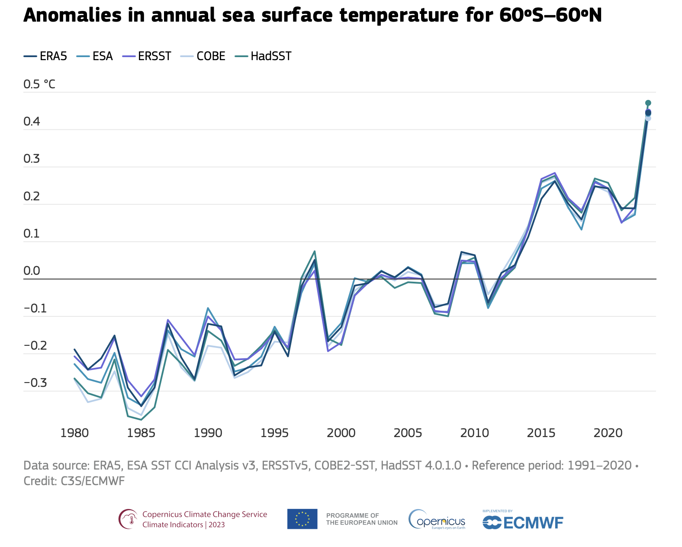
https://climate.copernicus.eu/climate-indicators/sea-surface-temperature

Slide 4
https://climate.copernicus.eu/climate-indicators/sea-surface-temperature

Slide 5
Phytoplankton
are adapted to specific
temperature ranges

Slide 6
Thermal reaction norms for Thalassiosira pseudonana
Growth Rate
Temperature °C
Boyd et al, PLoS ONE, 2013

Slide 7
Local adaptation
or
migration?

Slide 8
The long tail of biodiversity

Slide 9
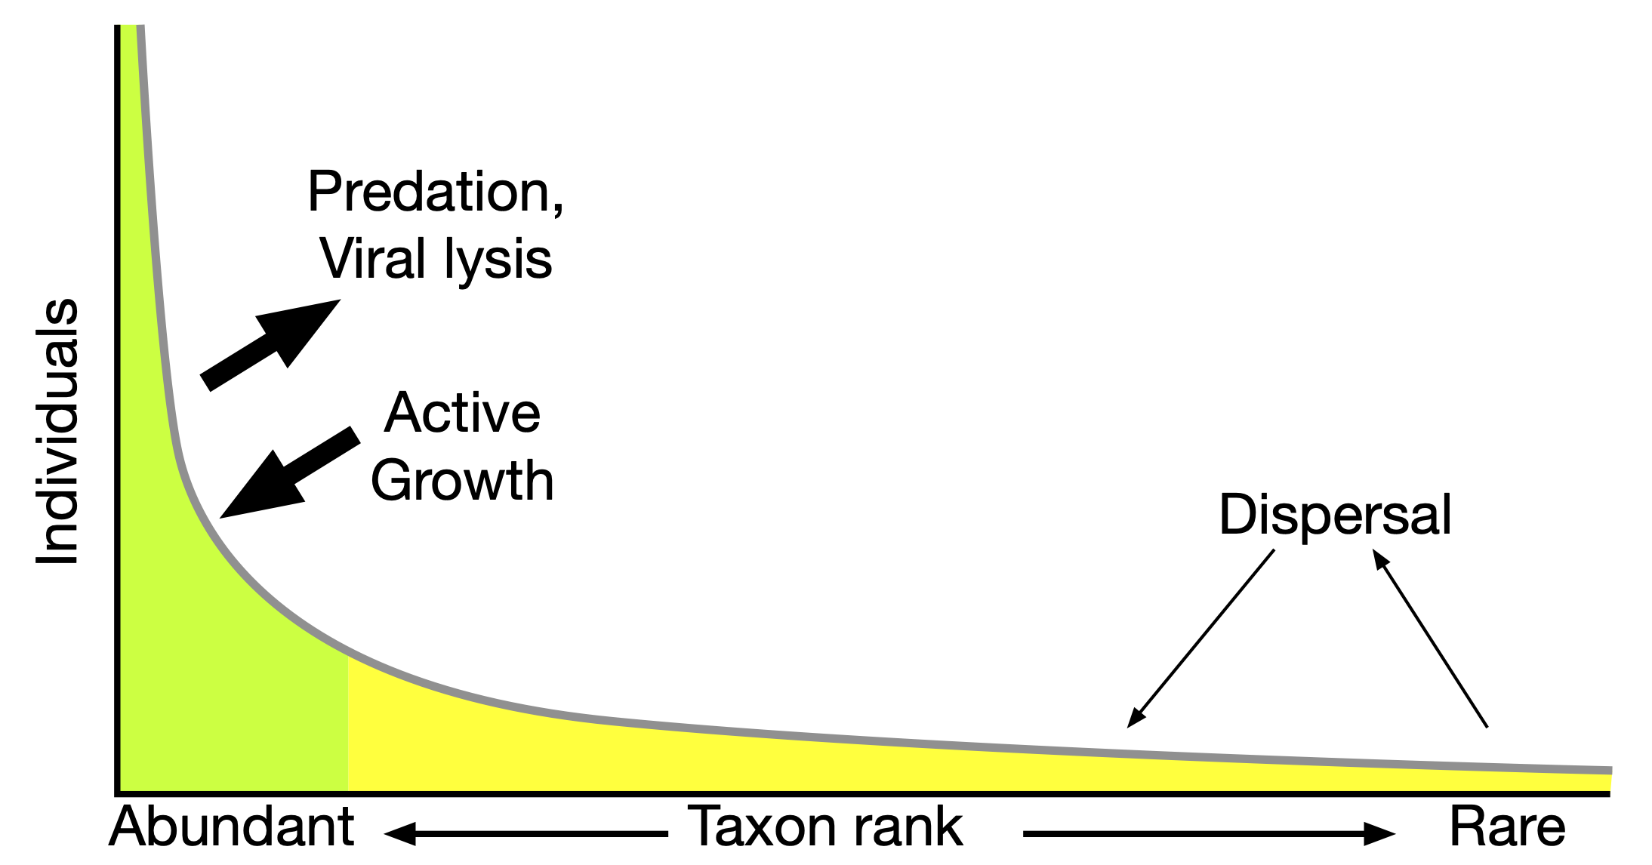
Carlós Pedro-Alió, TRENDS in Microbiology 2006

Slide 10
Surface ocean connectivity

Slide 11
How fast can genetic info
move
from point A to point B?

Slide 12
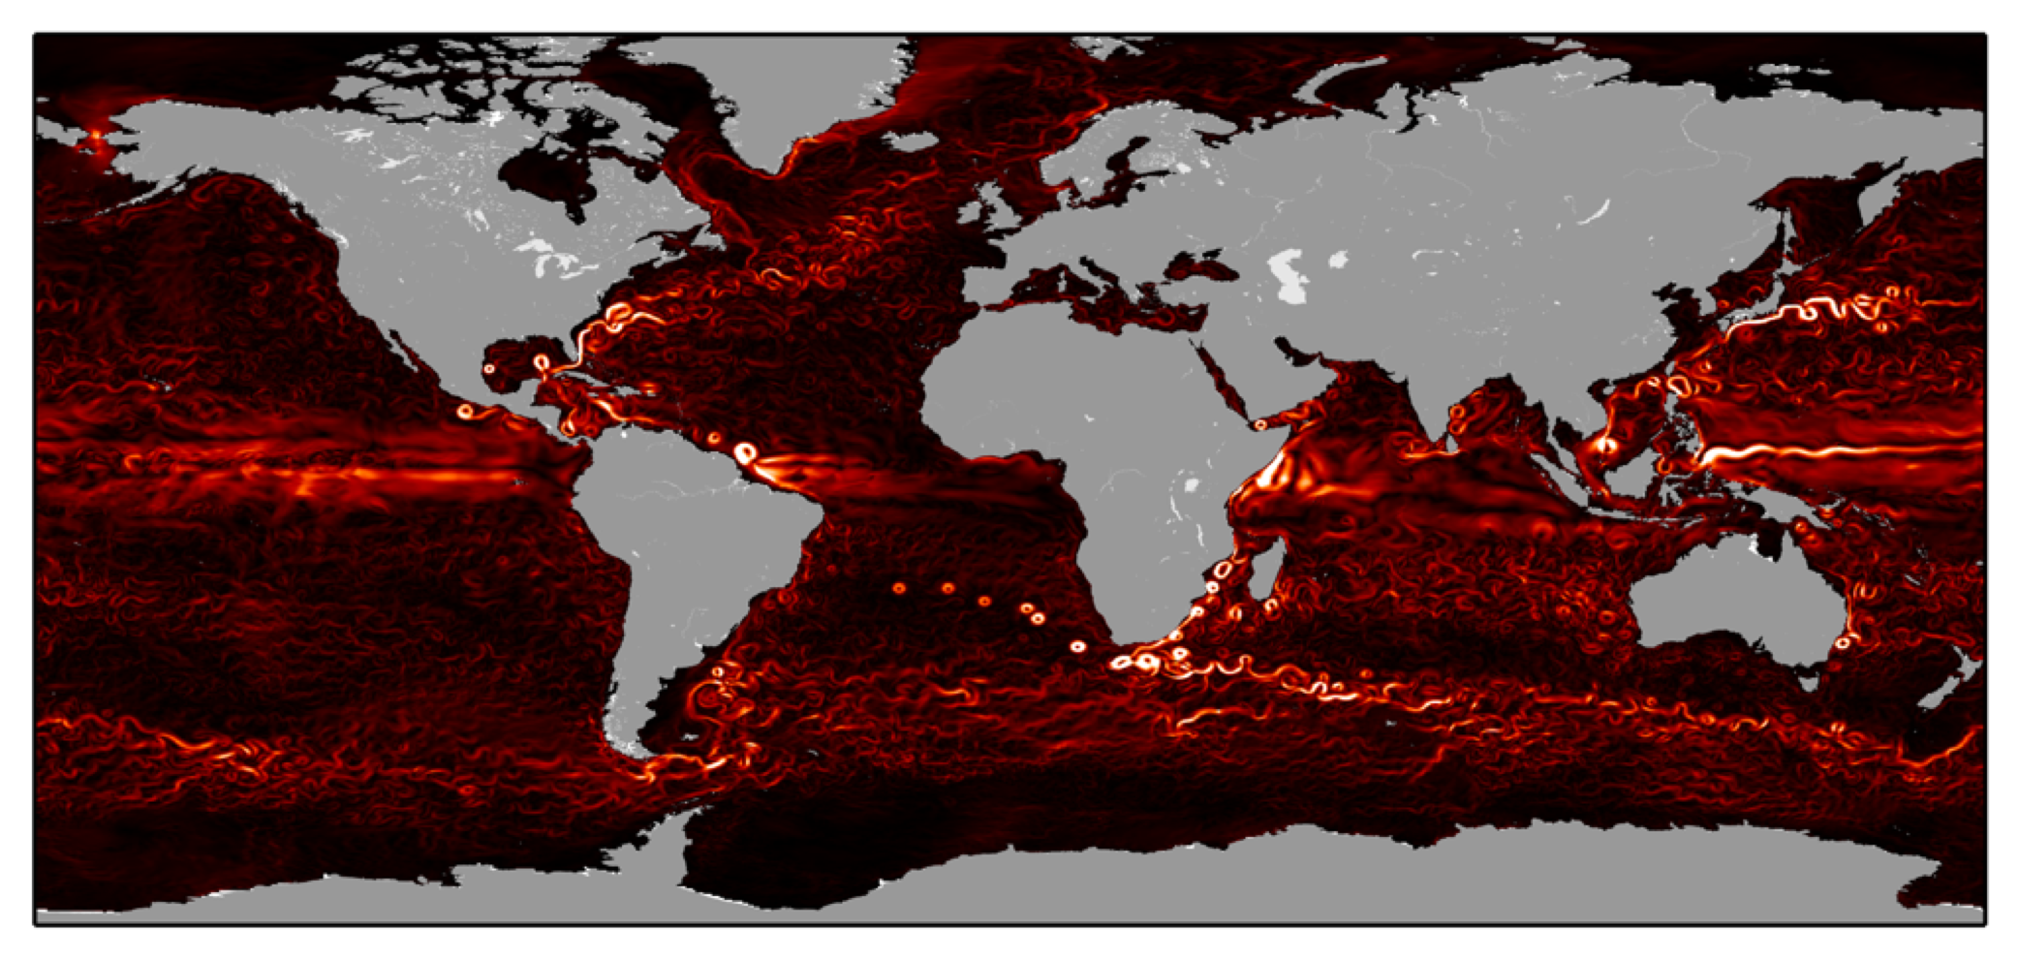
ECCO2 1/4° global state estimate

Slide 13

2° x 2° patches for connectivity

Slide 14
Minimum Connectivity Time

Slide 15
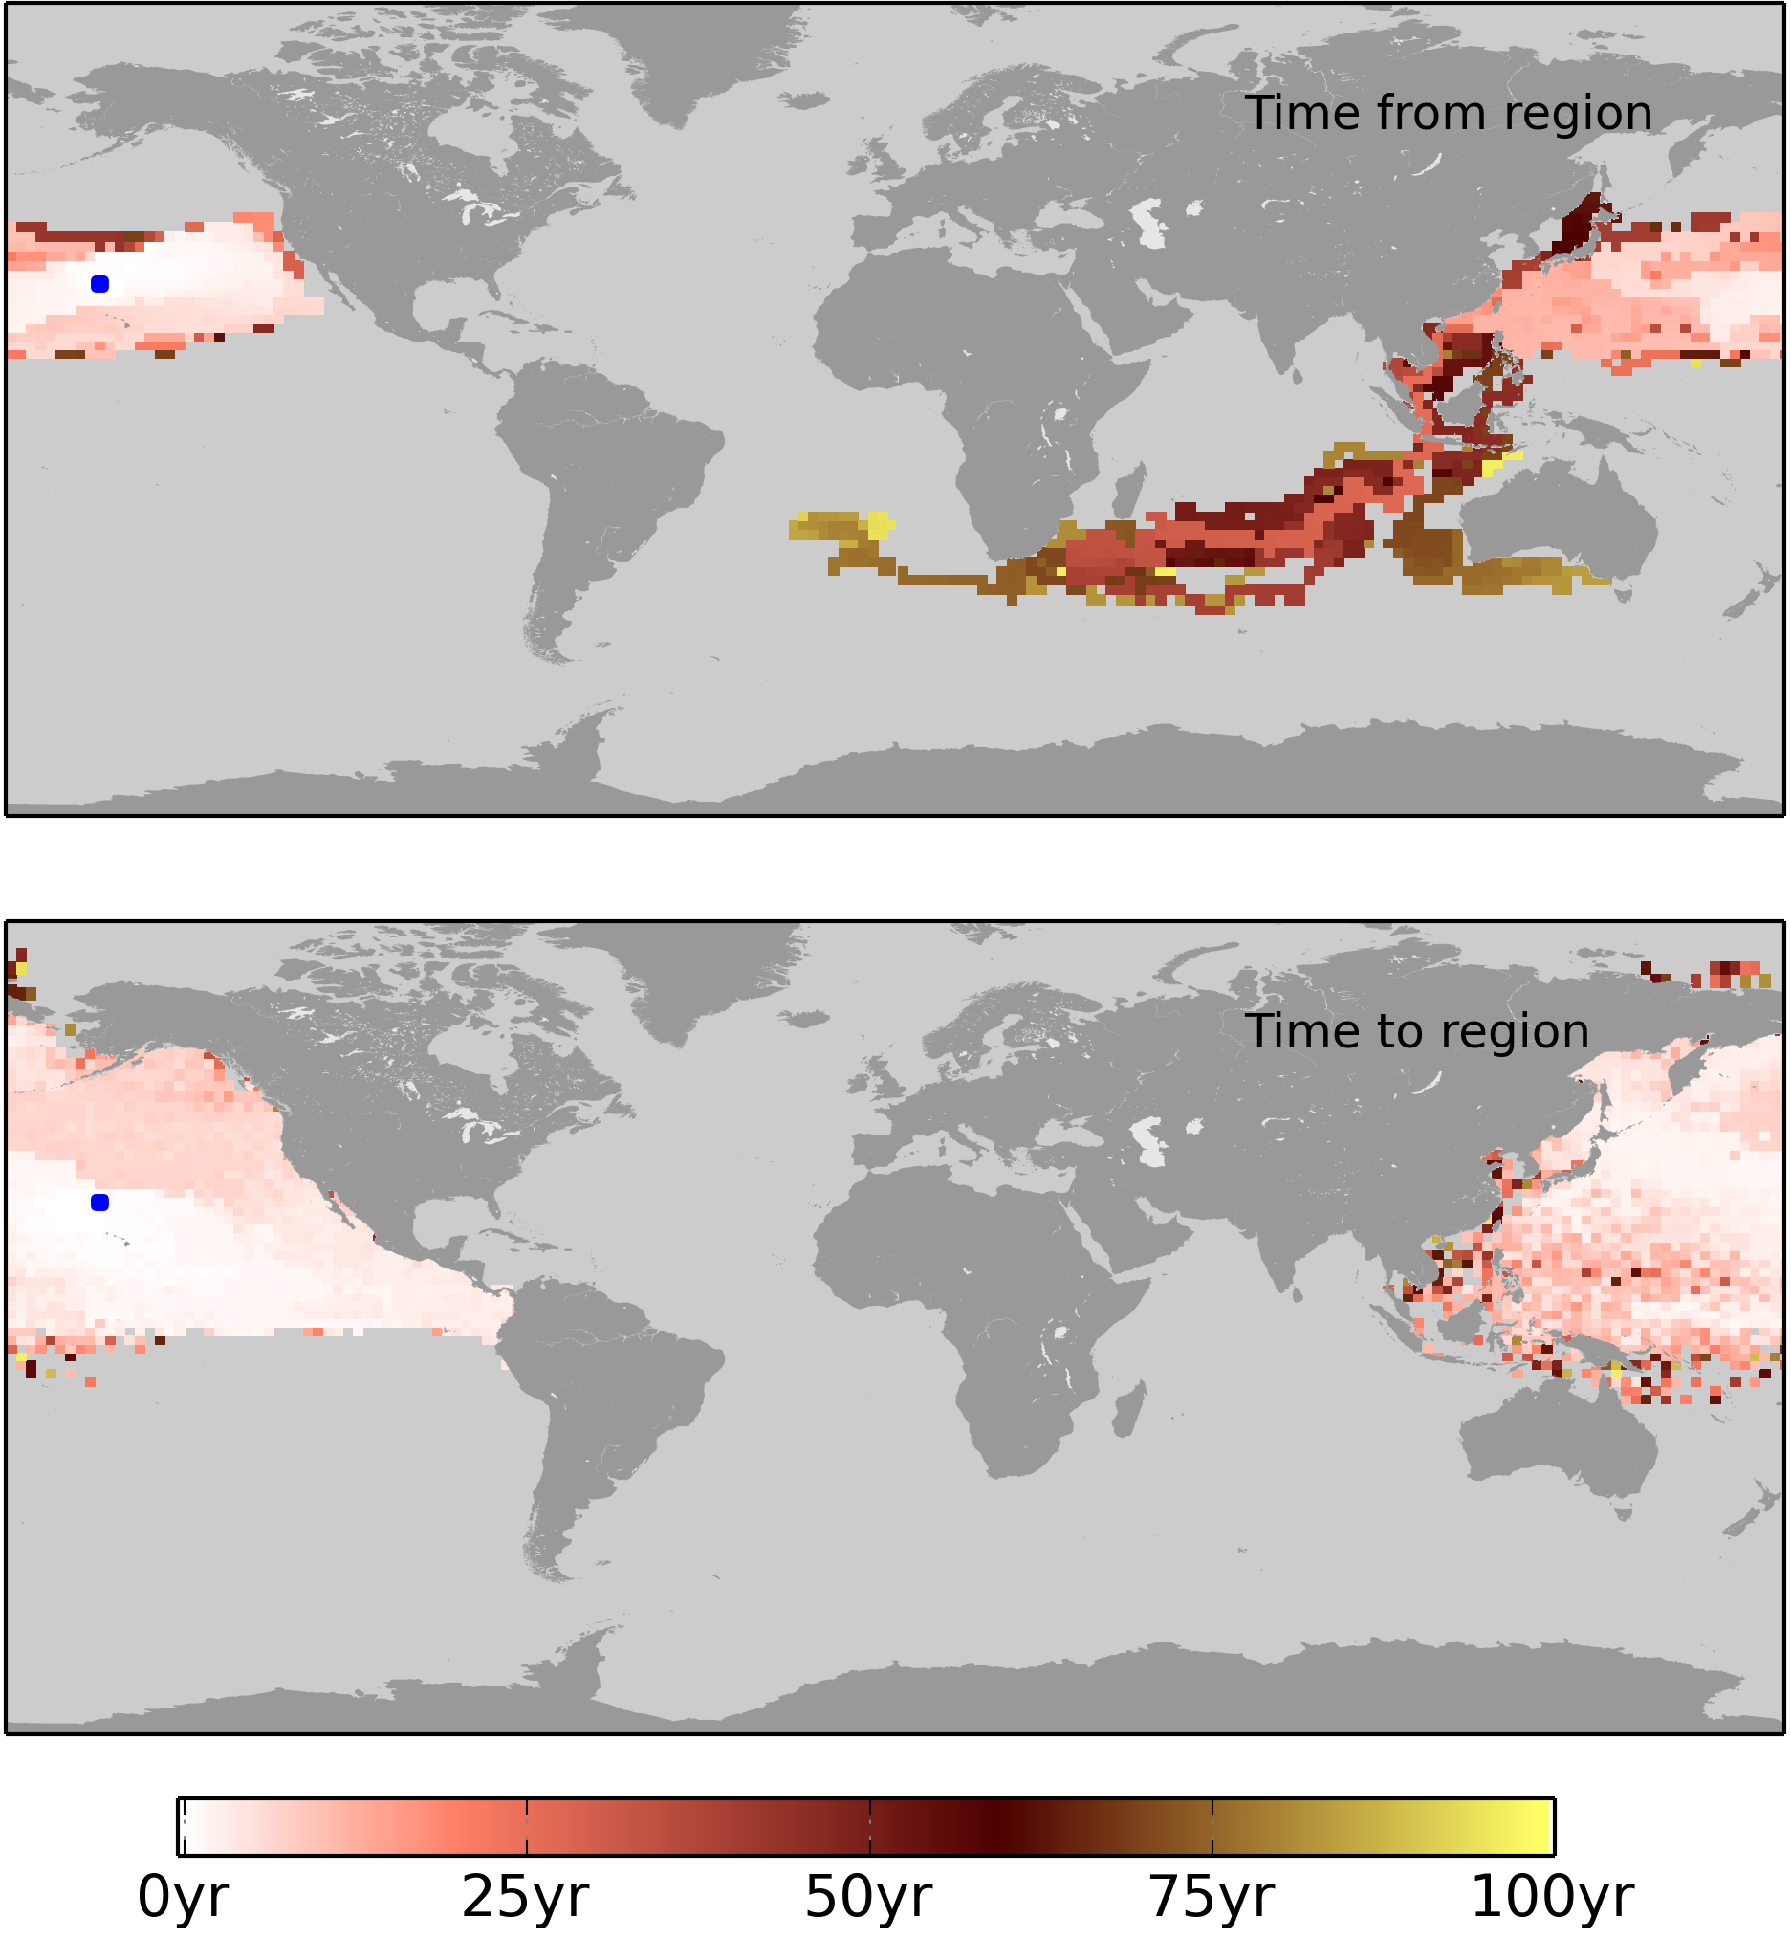
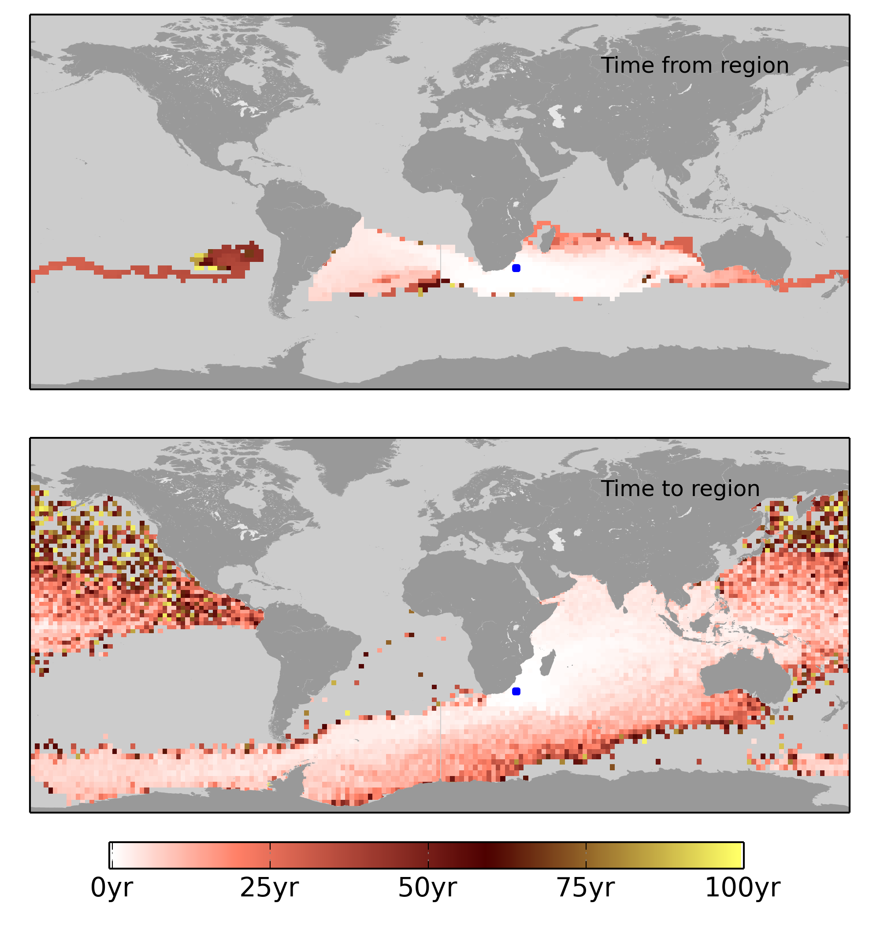

Slide 16
A
1
B
C
3
Dijkstra’s algorithm

Slide 17
A
1
6
B
C
3
Dijkstra’s algorithm

Slide 18
A
4
X
1
6
B
C
3
Dijkstra’s algorithm

Slide 19
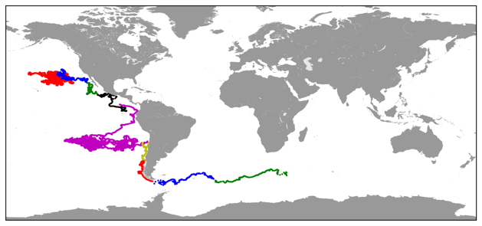

Slide 20
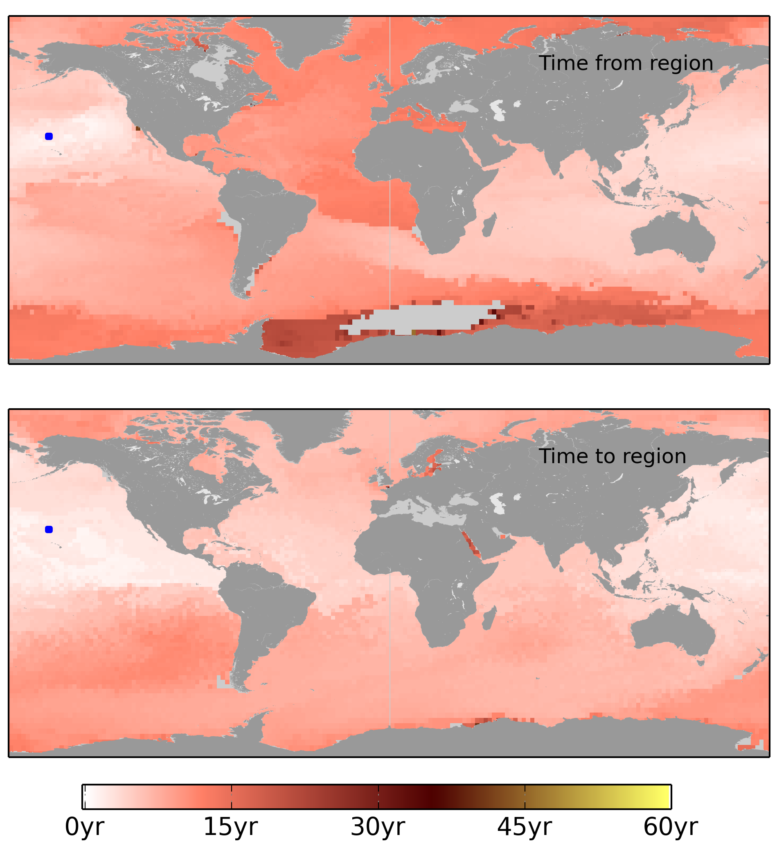
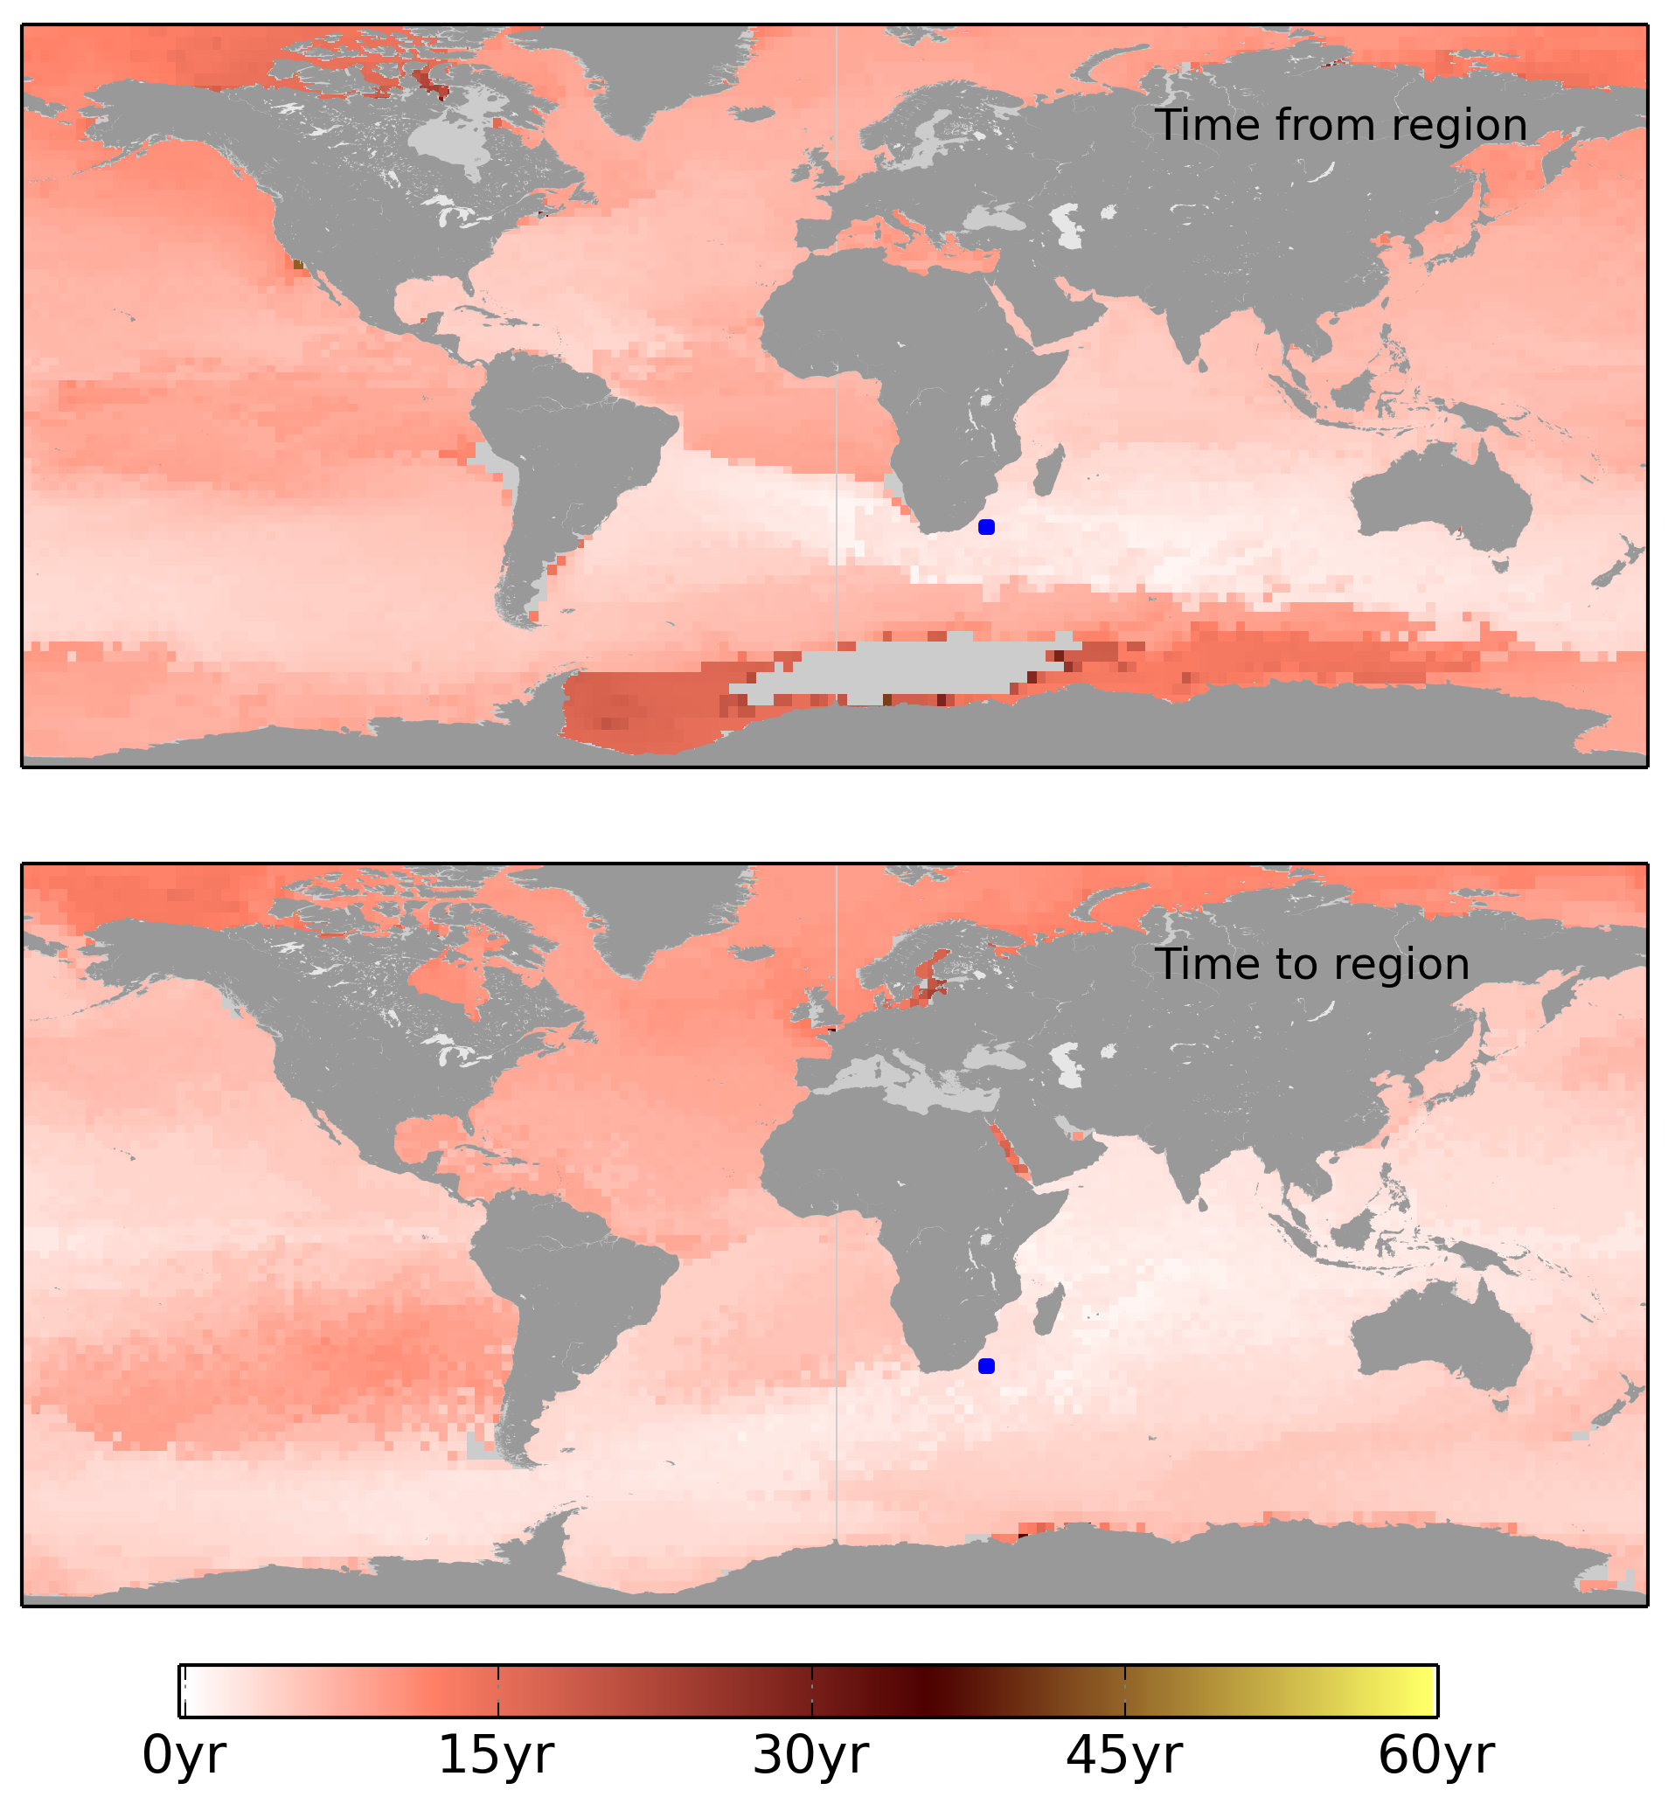

Slide 21
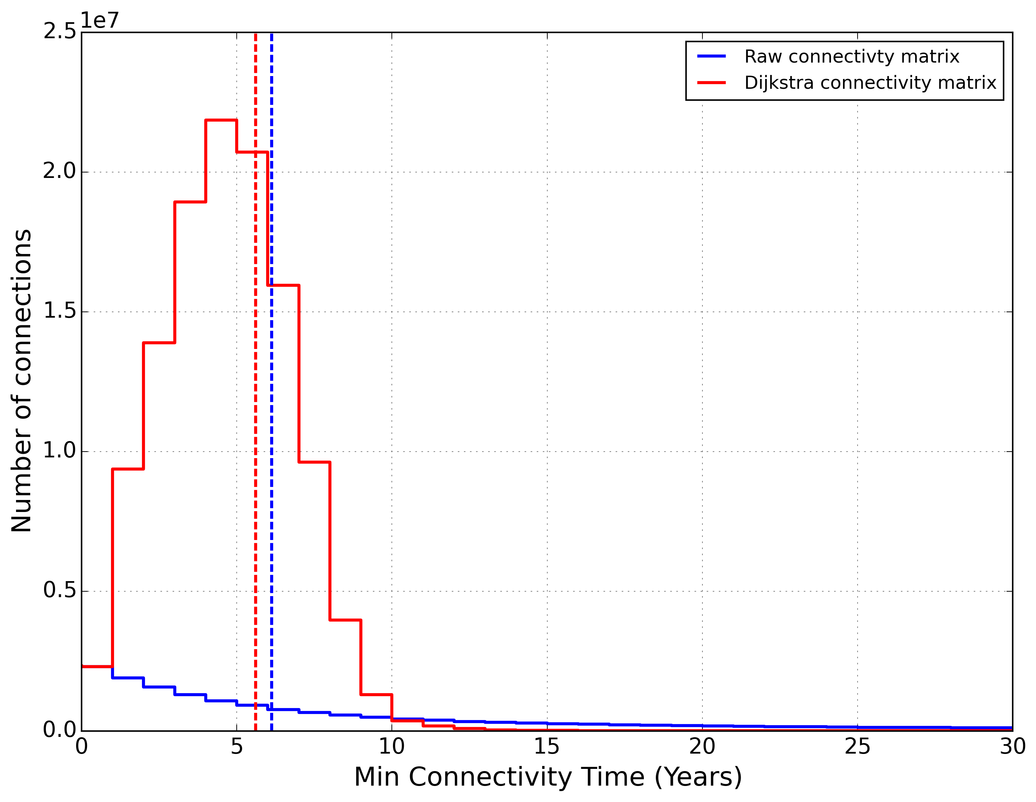

Slide 23
Time to travel 1°C

Slide 27
At least one degree warmer

Slide 28
Shortest time

Slide 29
Results

Slide 30
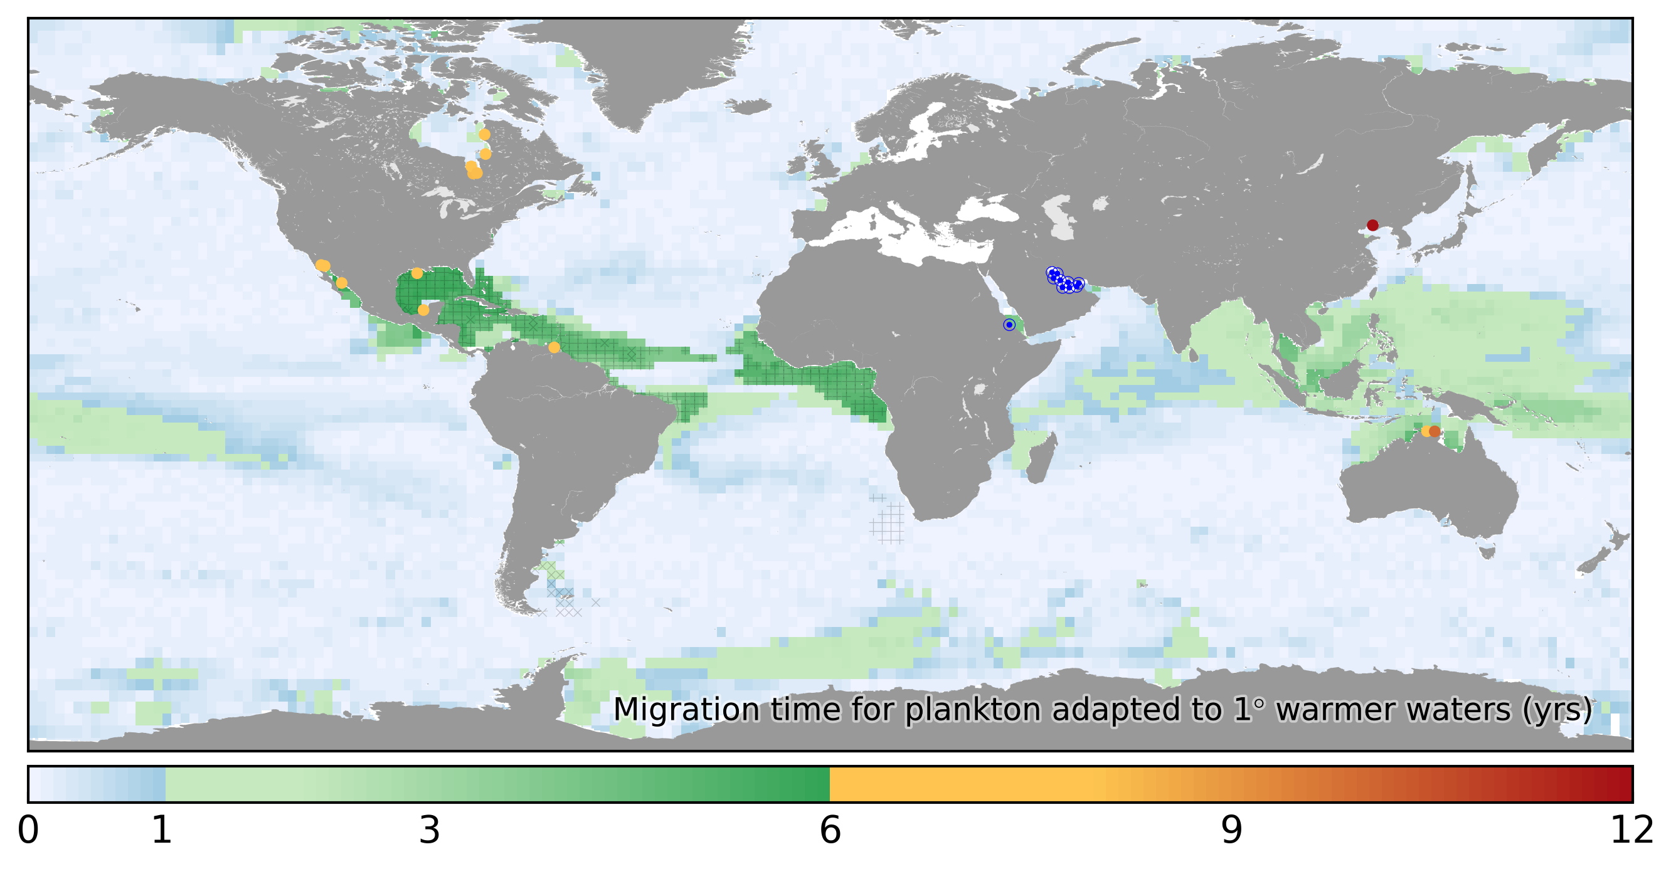
Migration time 1°C
Years

Slide 31
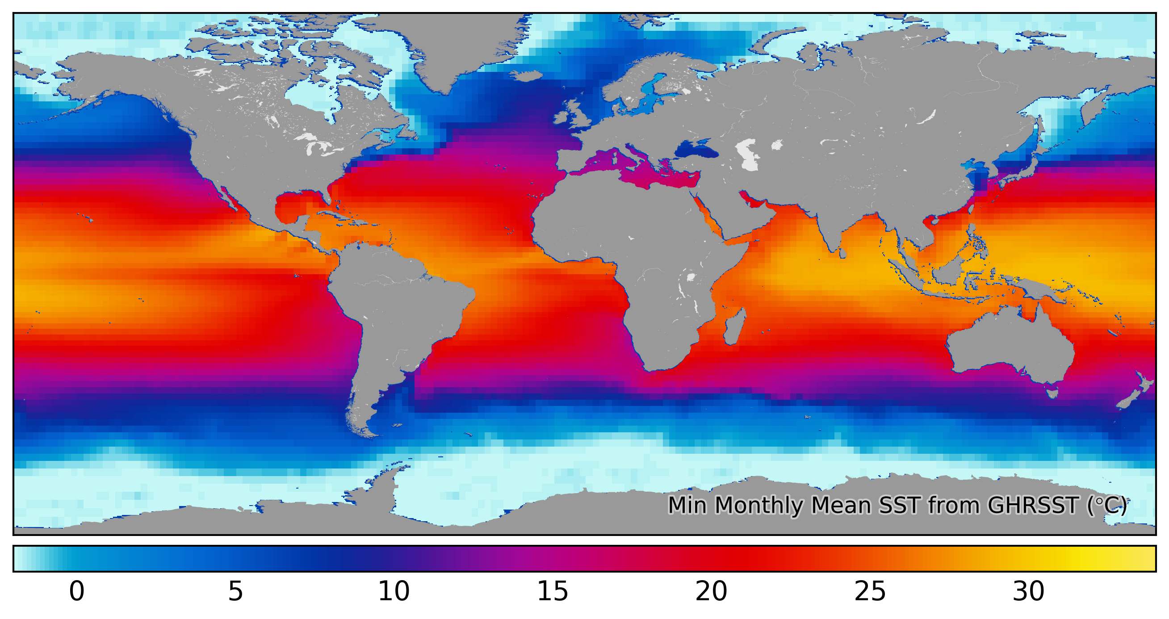
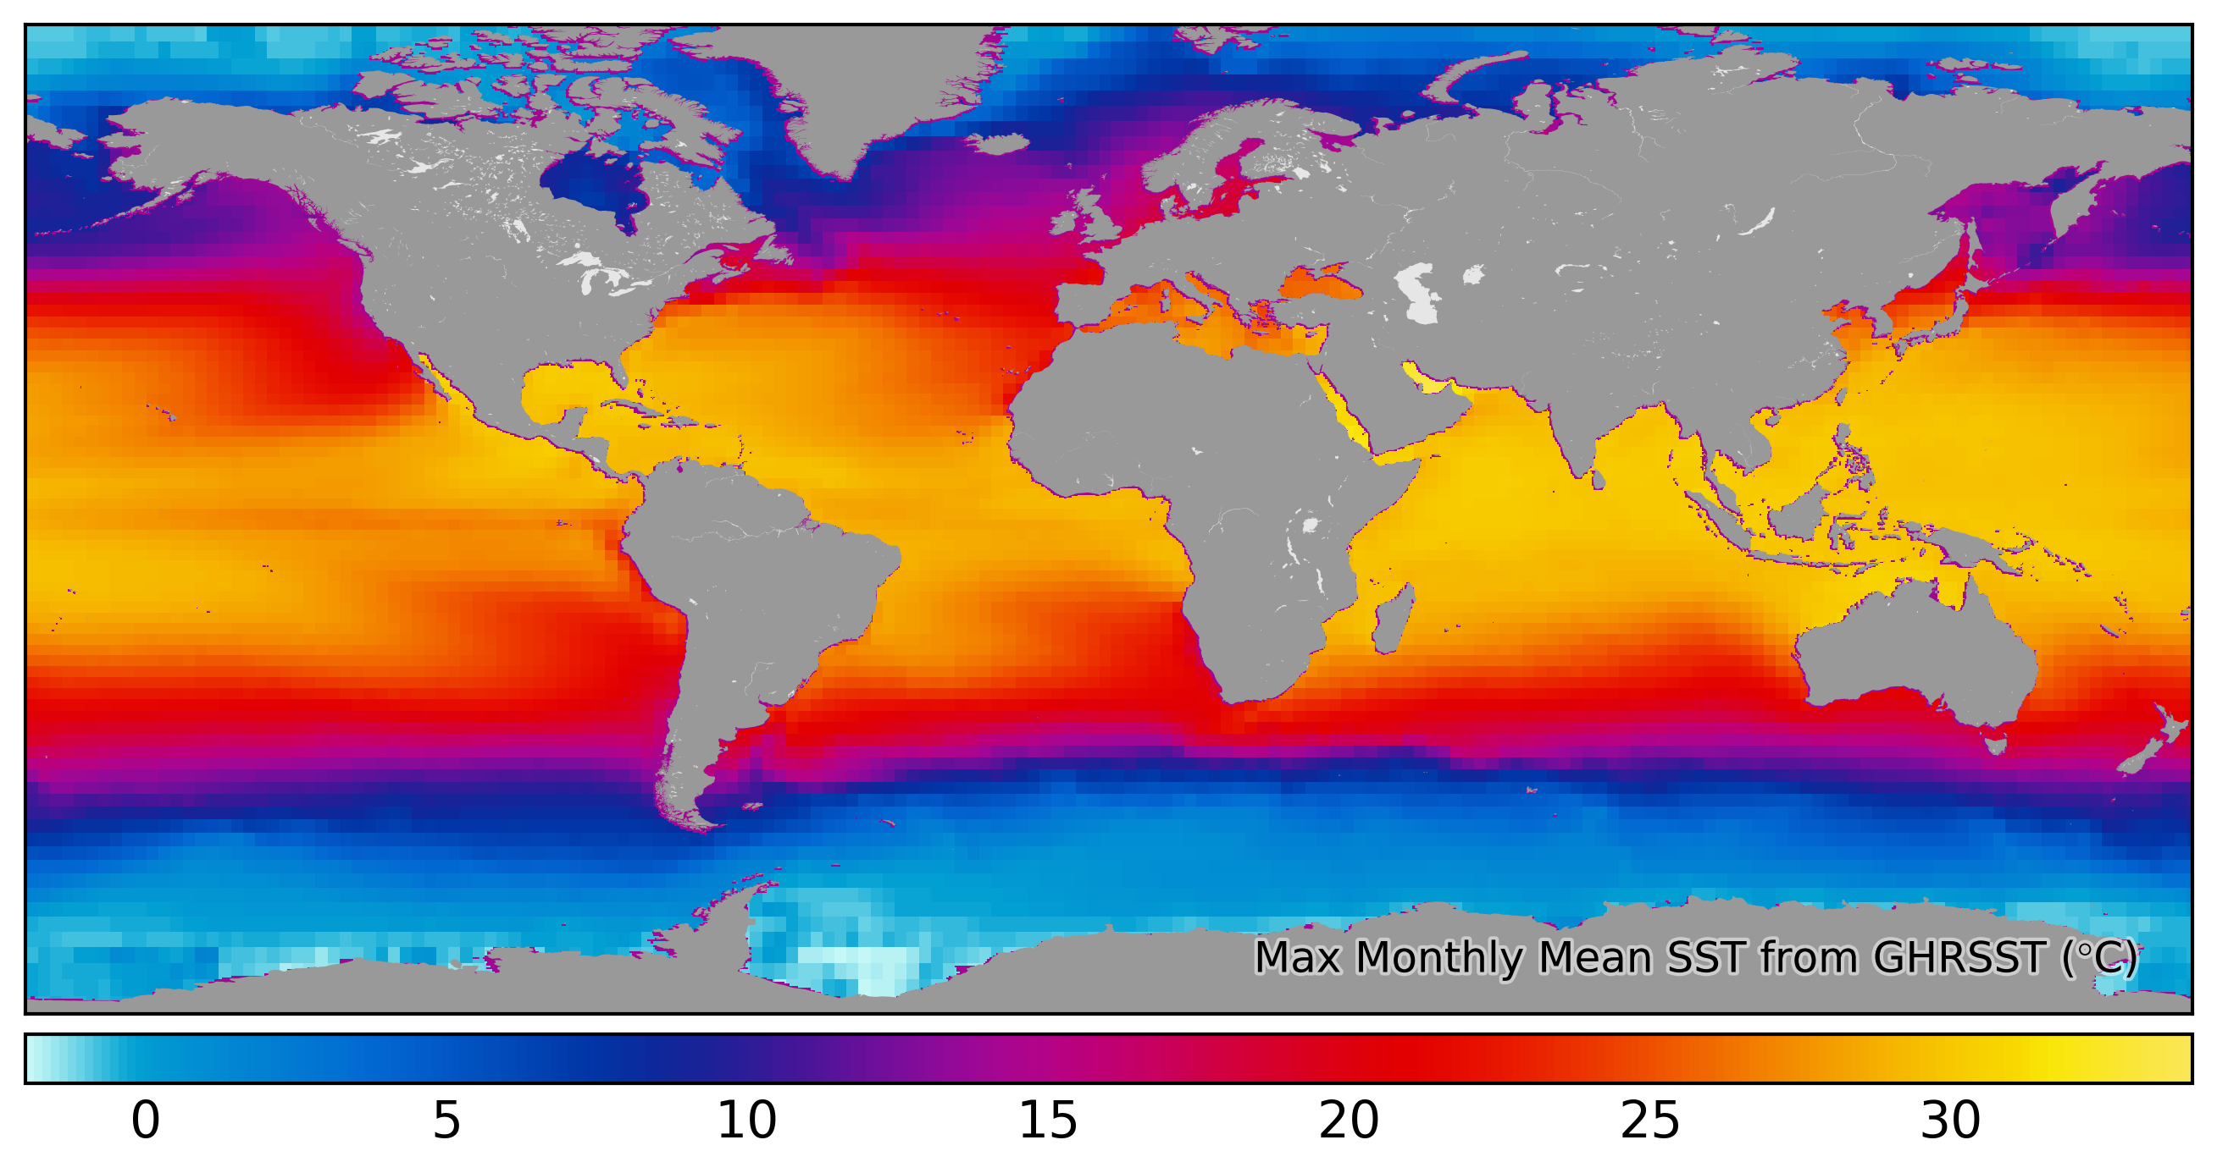
Coldest months
Hottest months

Slide 32
Migration time 1°C
Years

Slide 33
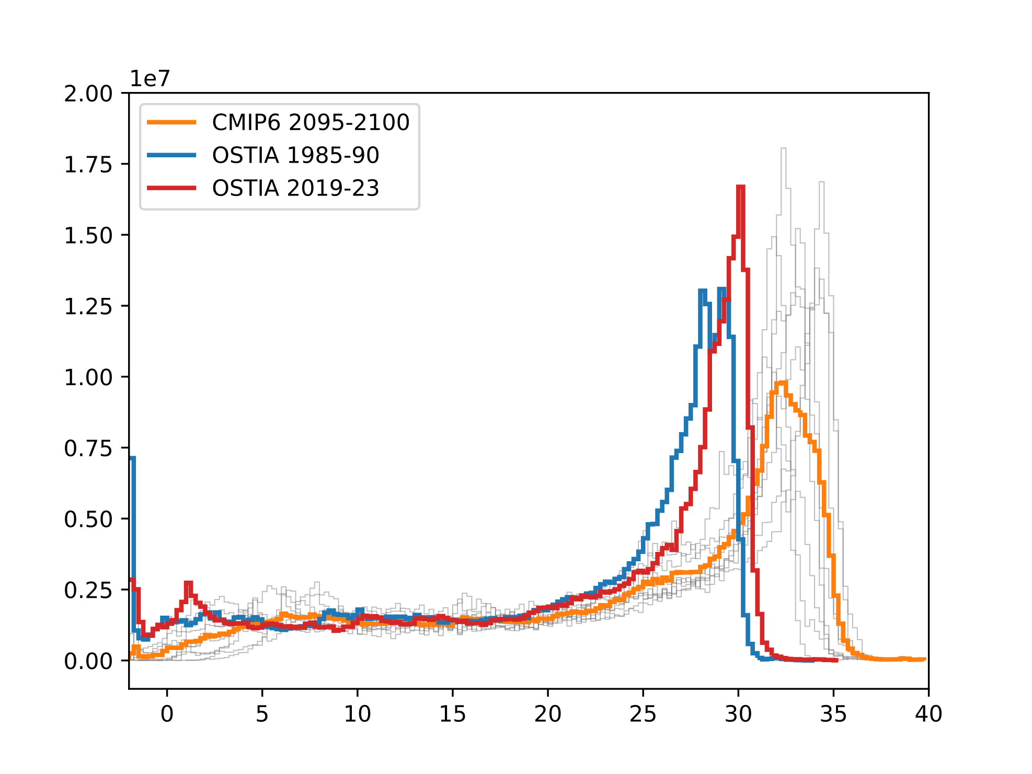
Area (km²)
SST (°C)

Slide 34

Tipping points
Area (km²)
SST (°C)

Slide 35
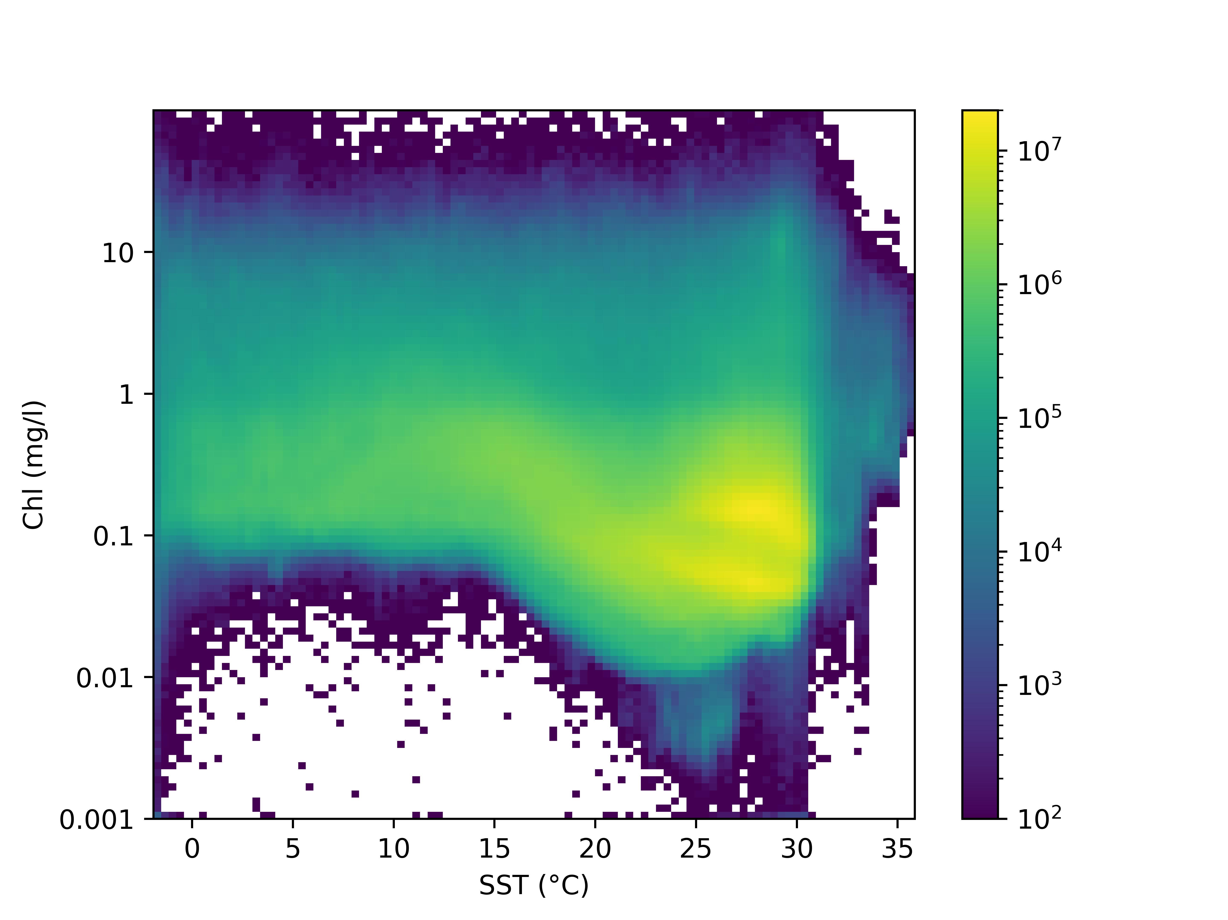
Area (km²)

Slide 36
Boyd et al, PLoS ONE, 2013

Slide 37
?
Area (km²)
?
?

Slide 38
?
Area (km²)
?

Slide 39
Conclusions

Slide 40
Things move in the ocean!

Slide 41
Connection times are short

Slide 42
Connection times are short
Migration sufficient

Slide 43
Connection times are short
Migration sufficient
Regions of concern

Slide 44
Connection times are short
Migration sufficient
Regions of concern
Seed banks

Slide 45
Connection times are short
Migration sufficient
Regions of concern
Seed banks
Lagrangian frame

Slide 46
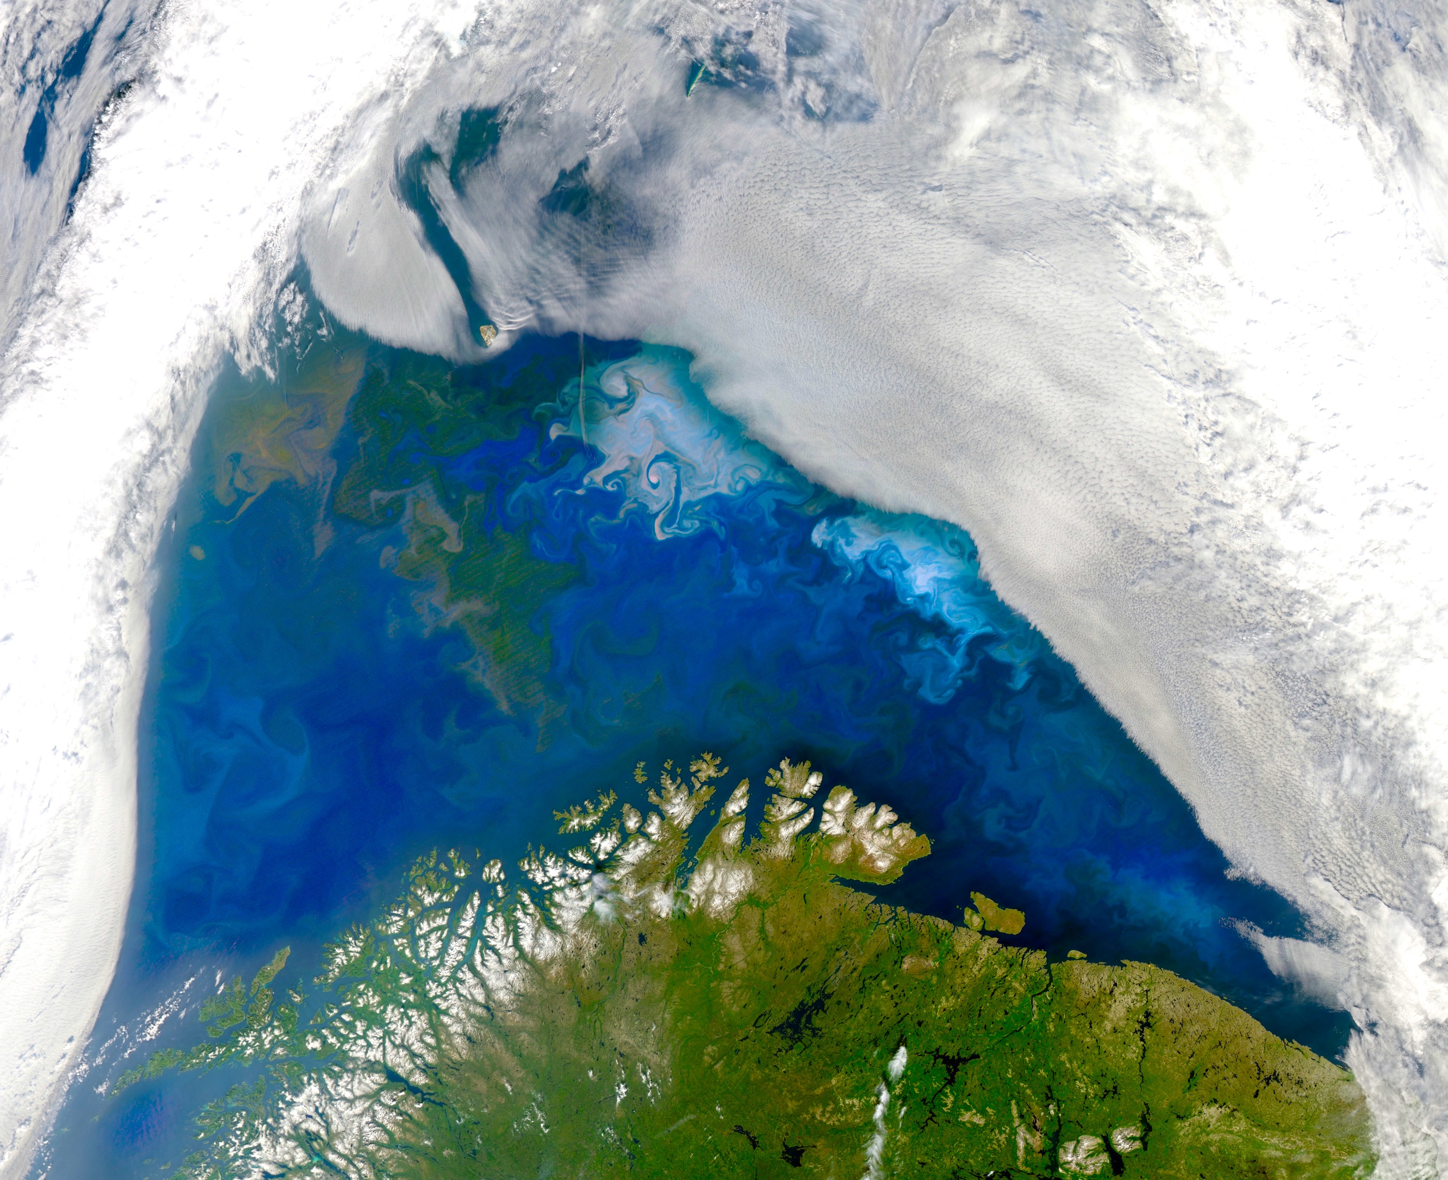
bror.jonsson@unh.edu
MODIS 2011-09-10
100 km

Slide 47
bror.jonsson@unh.edu

Slide 48
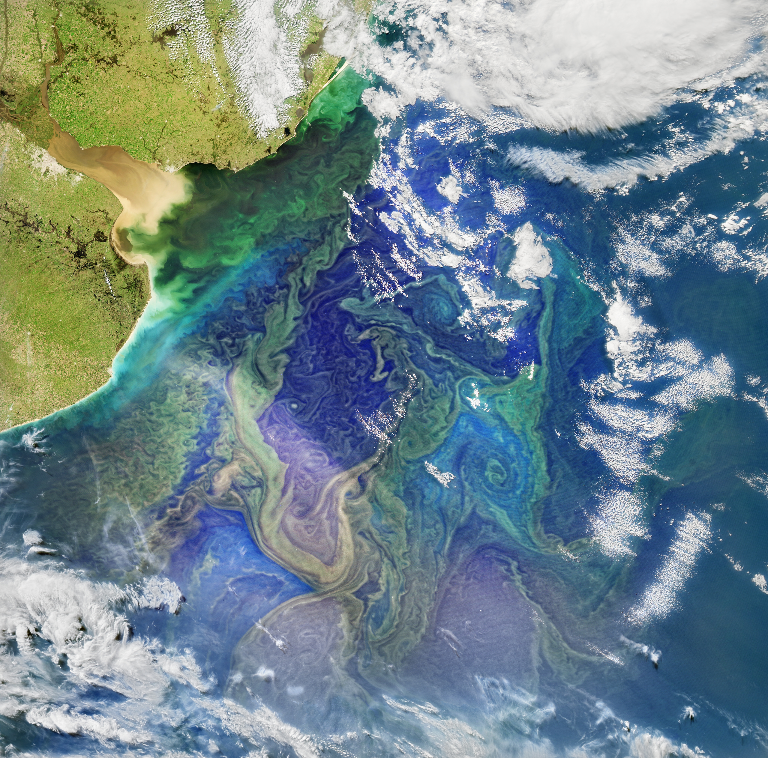
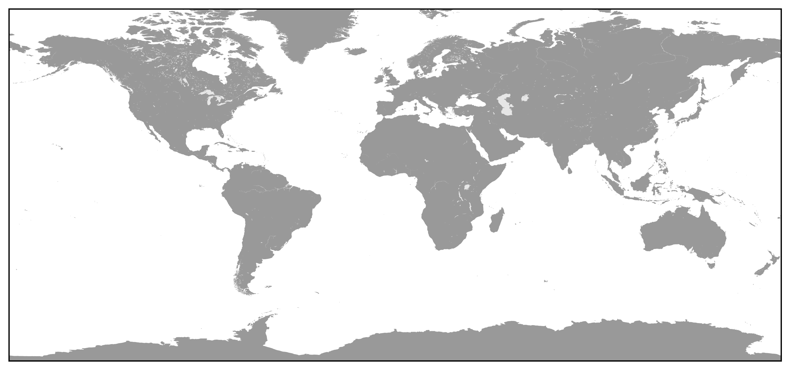
MODIS 2015-09-01

Slide 49
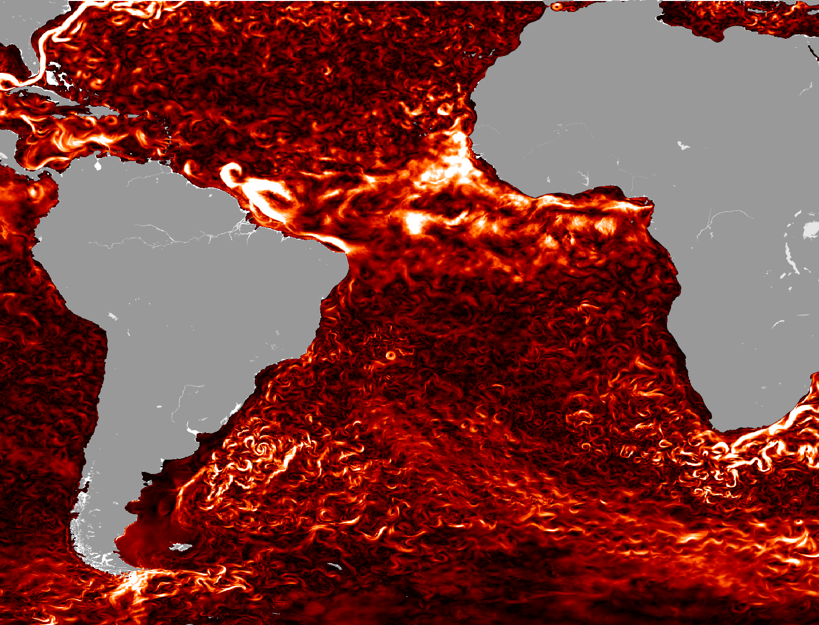
HYCOM 2015-09-01

Slide 50
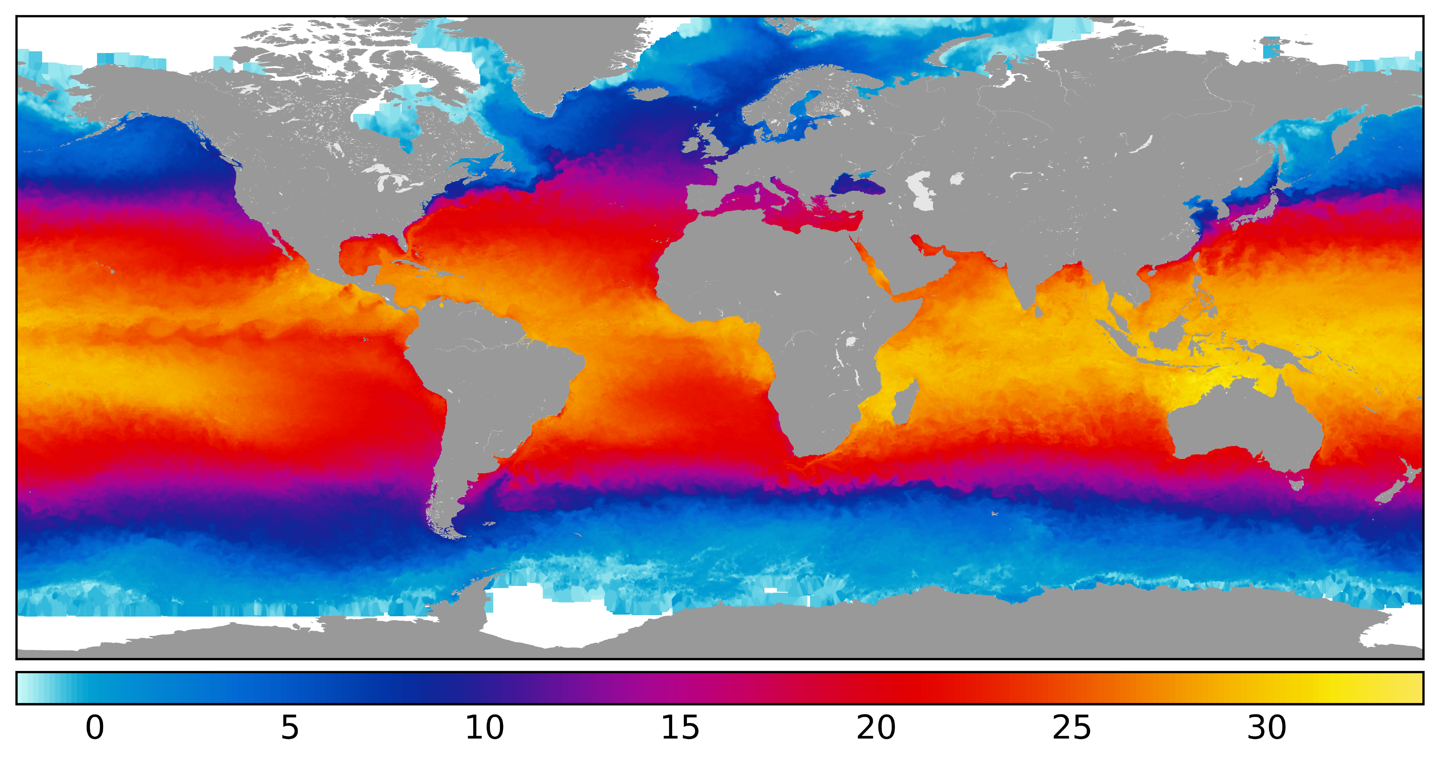
GHRSST 2014-01-01

