Slide 1


Isolation and Connectivity:
Why Scales are Critical
Bror F. Jönsson UNH
Joseph Salisbury UNH
Elizabeth C. Atwood PML
Shubha Sathyendranath PML
Amala Mahadevan WHOI

Slide 2
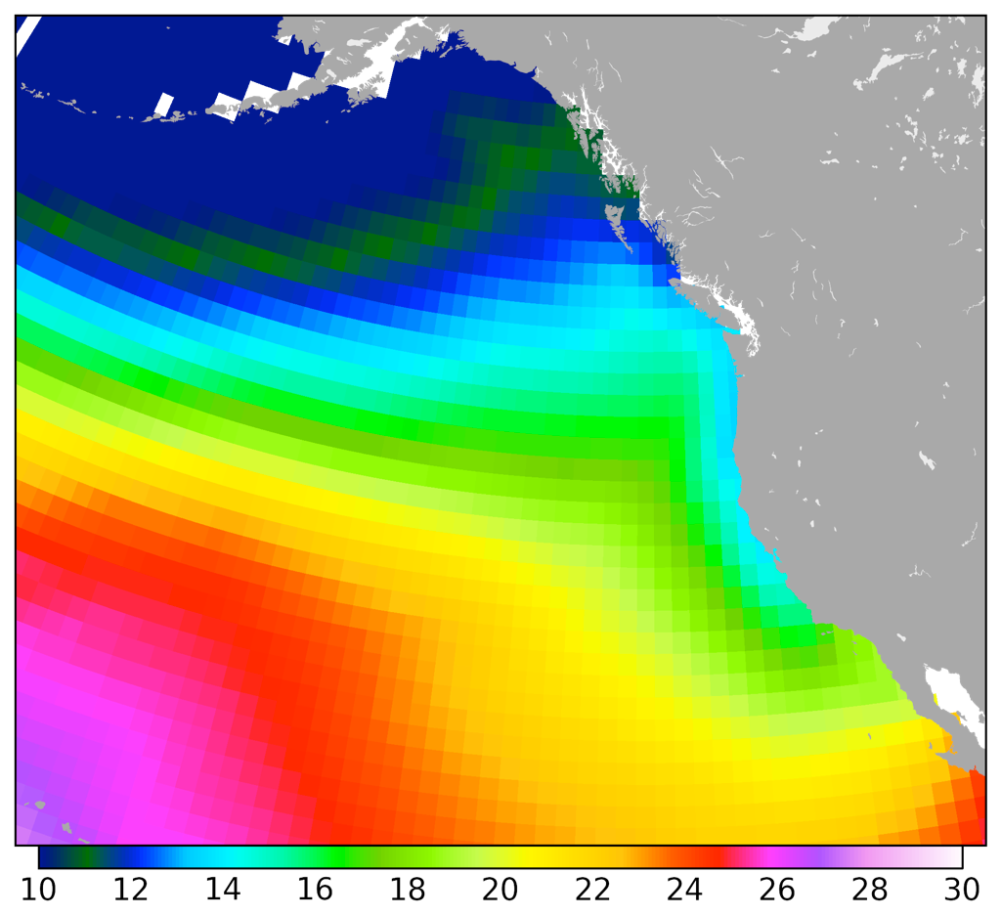
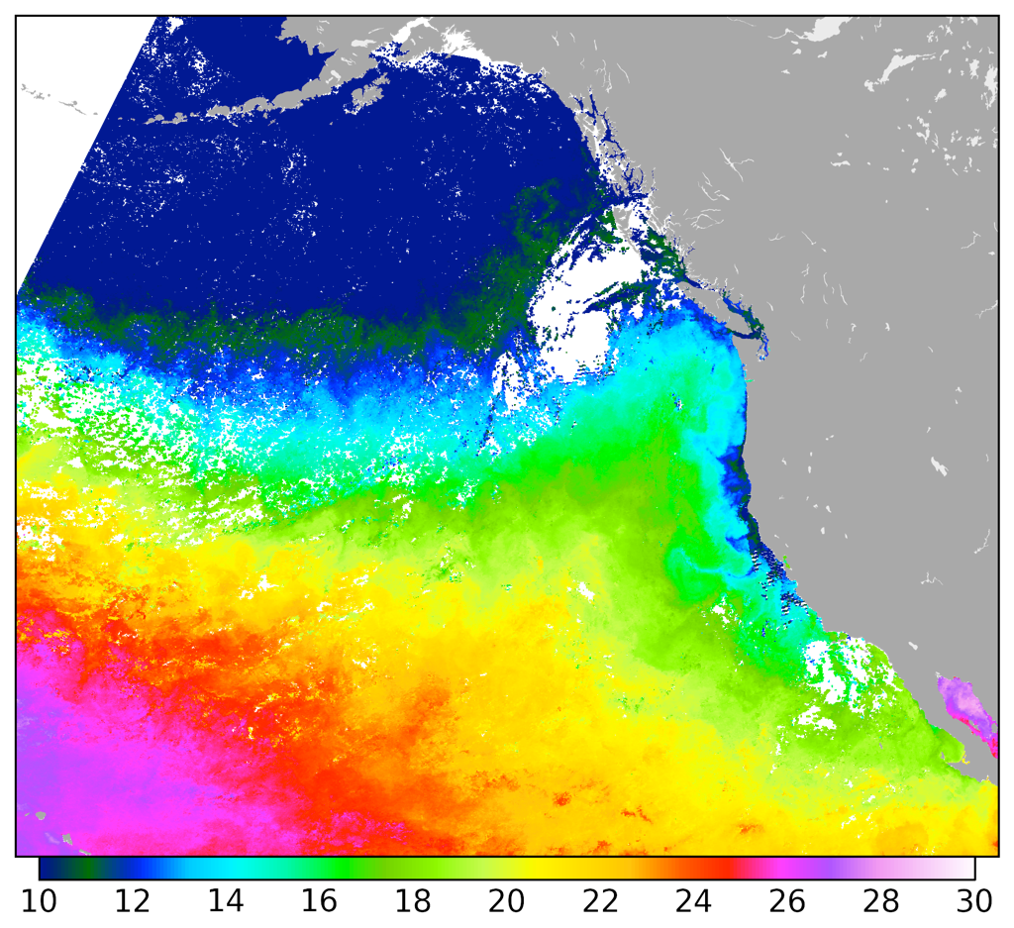
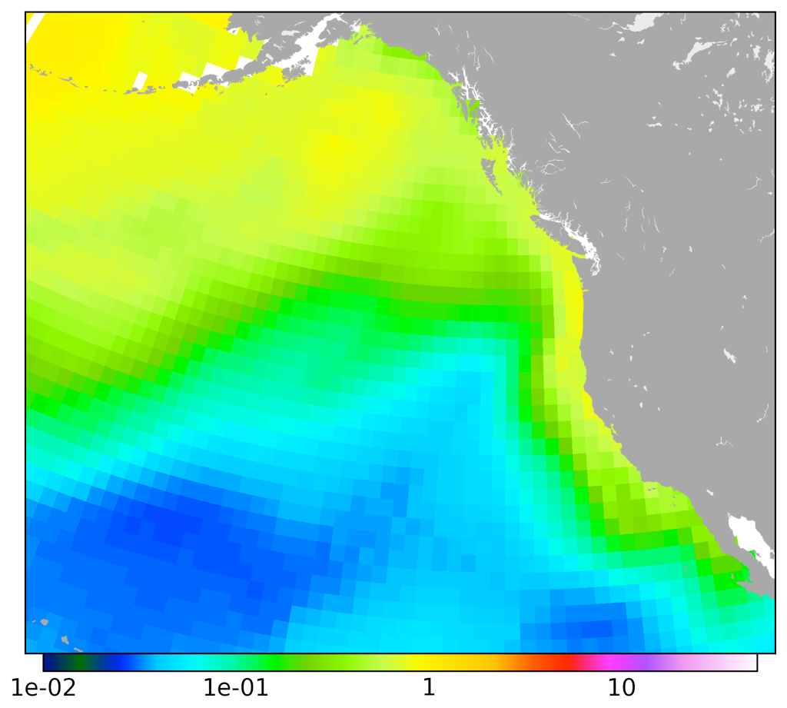
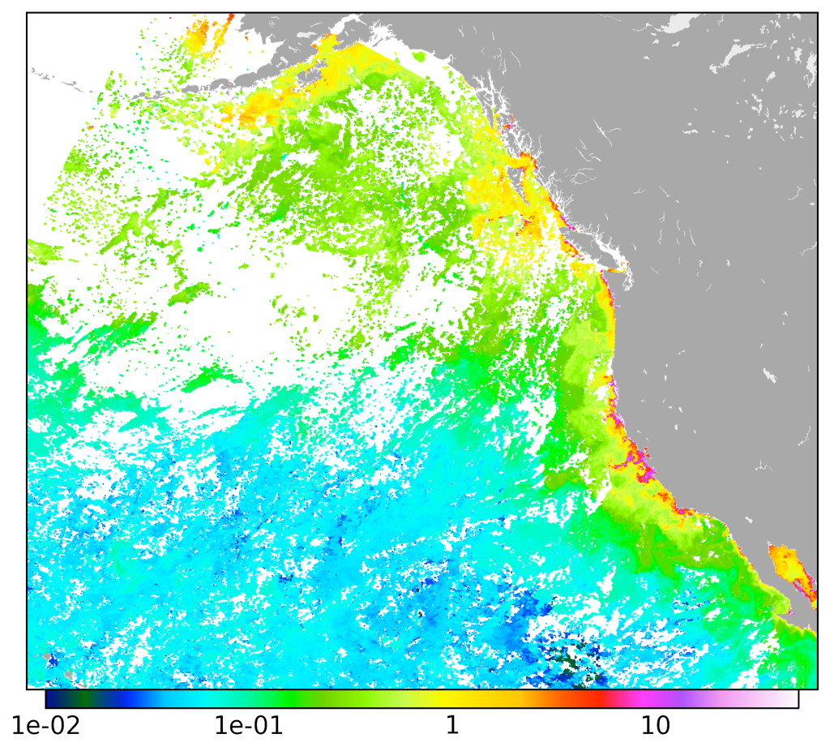
Ocean models are increasing their spatial resolution.
GFDL/TOPAZ “2005-10-16”
MODIS Aqua 2005-10-16 – 23
SST
Chl

Slide 3
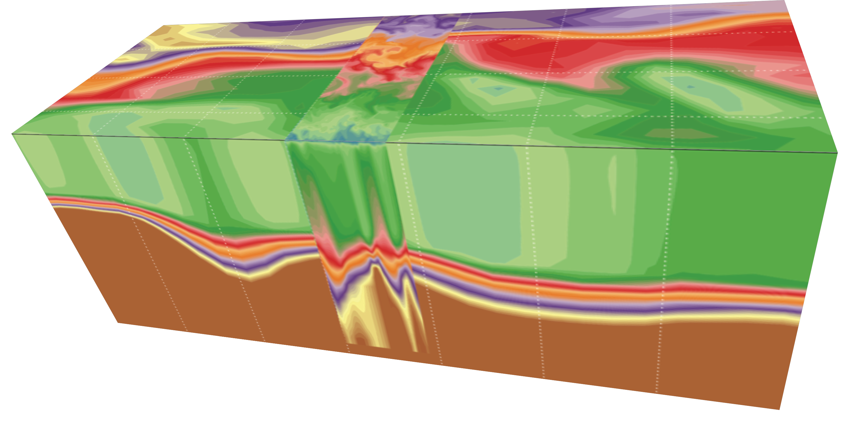
Ocean models with high spatial resolution require processes resolved on short temporal scales.
ECCO, 1/4° resolution
Color represents density
PSOM, 1 km resolution
57°N
56°N
55°N
0 m
100 m
200 m
33°W
31°W
29°W
27°W
300 m

Slide 4
Primary Production Using a Lagrangian Frame
Dominating timescales of variability
Global Ocean Connectivity and Refuge Regions

Slide 5

Estimate biological production in a Lagrangian frame
Combine satellite data and physical fields
Assume non steady state
Day5
Day4
Day3
Day2
Day1
Biological production
Jönsson et al. 2009

Slide 6
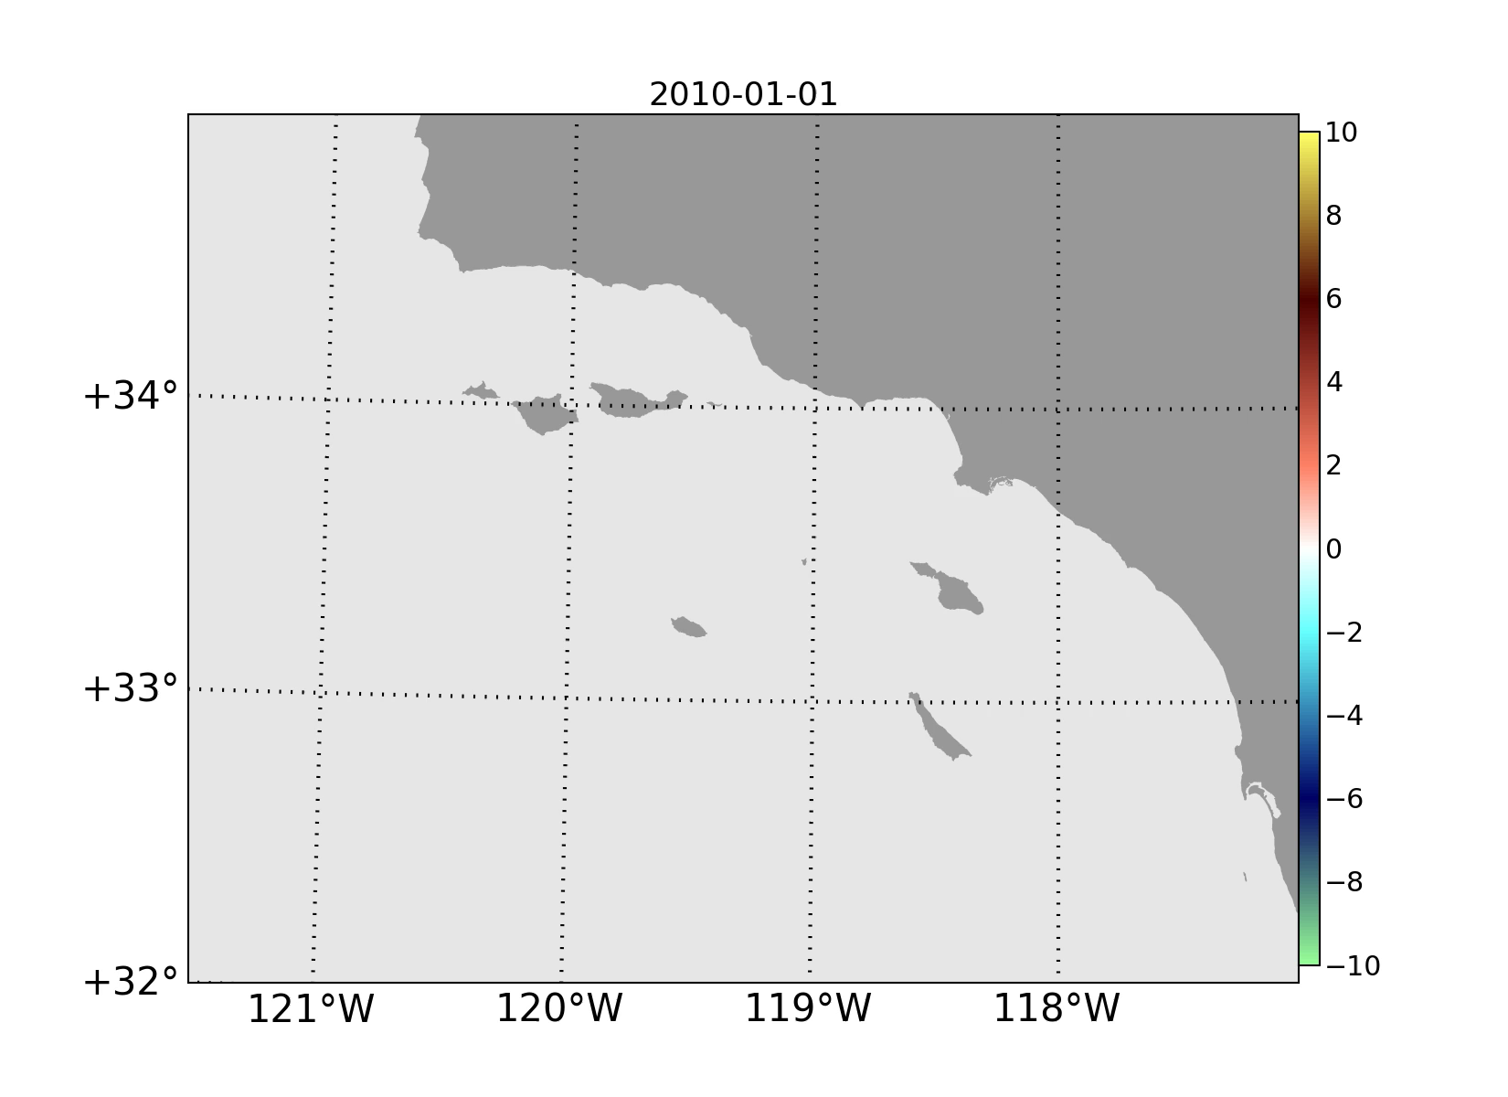
Change, Chl (mg m³ d⁻¹)
Jönsson & Salisbury 2016

Slide 7
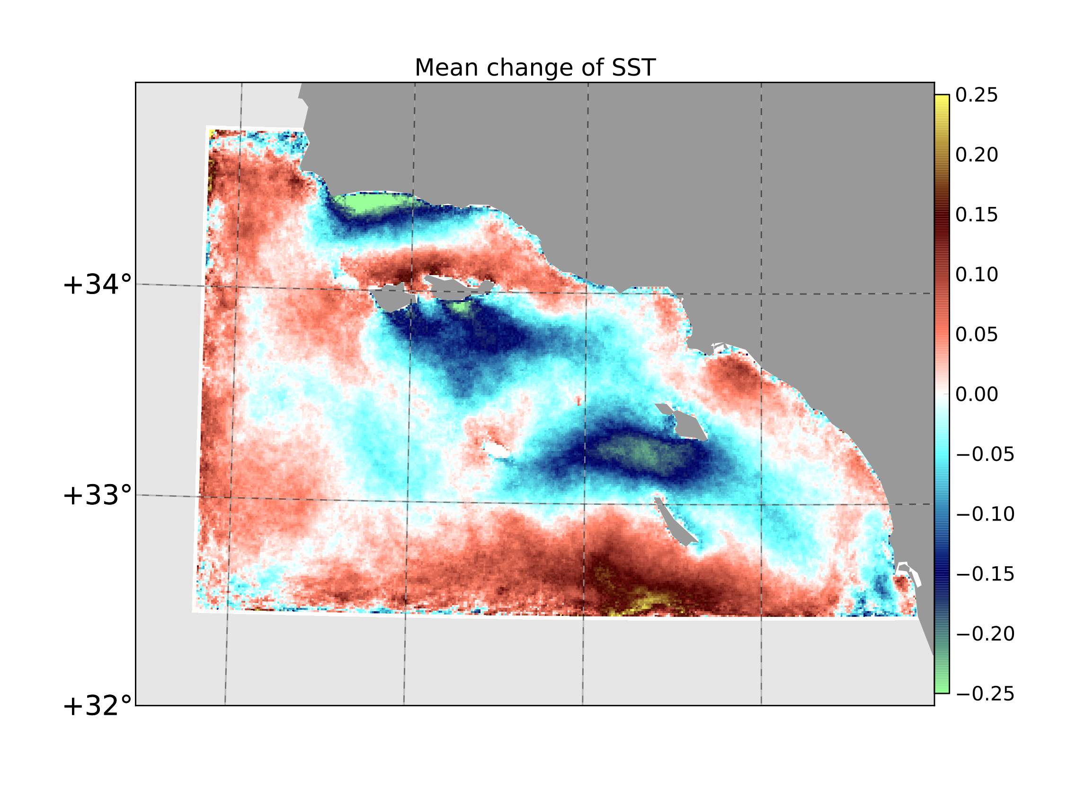
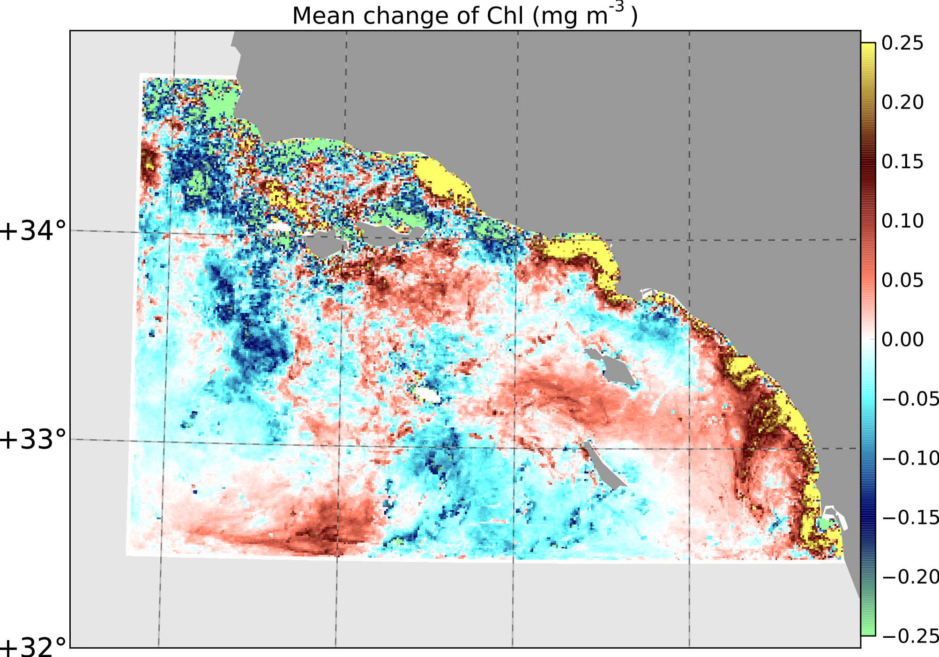
Mean change, Chl (mg m⁻³ d⁻¹)
Mean change, SST (°C d⁻¹)
0.25
0.25
0
0
-0.25
-0.25
Jönsson & Salisbury 2016

Slide 8
Primary Production Using a Lagrangian Frame
Dominating timescales of variability
Global Ocean Connectivity and Refuge Regions

Slide 9
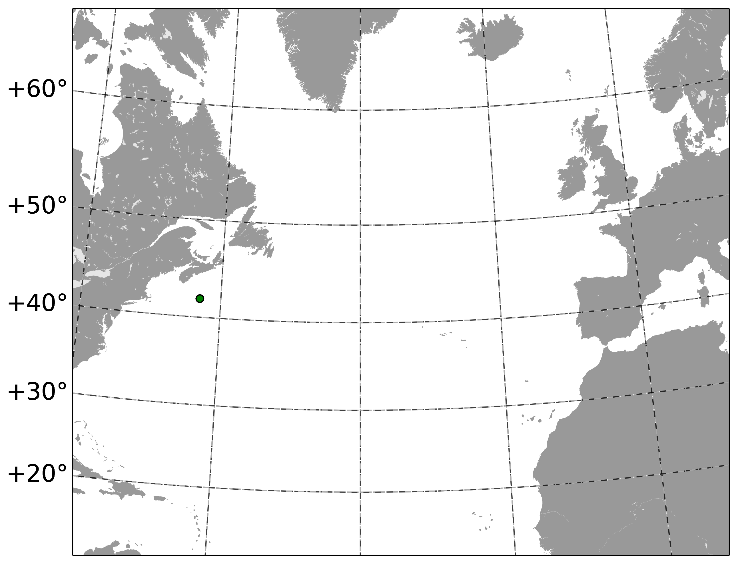
CCI 4km resolution 63°W 42°N

Slide 10
CCI 4km resolution 63°W 42°N

Slide 11
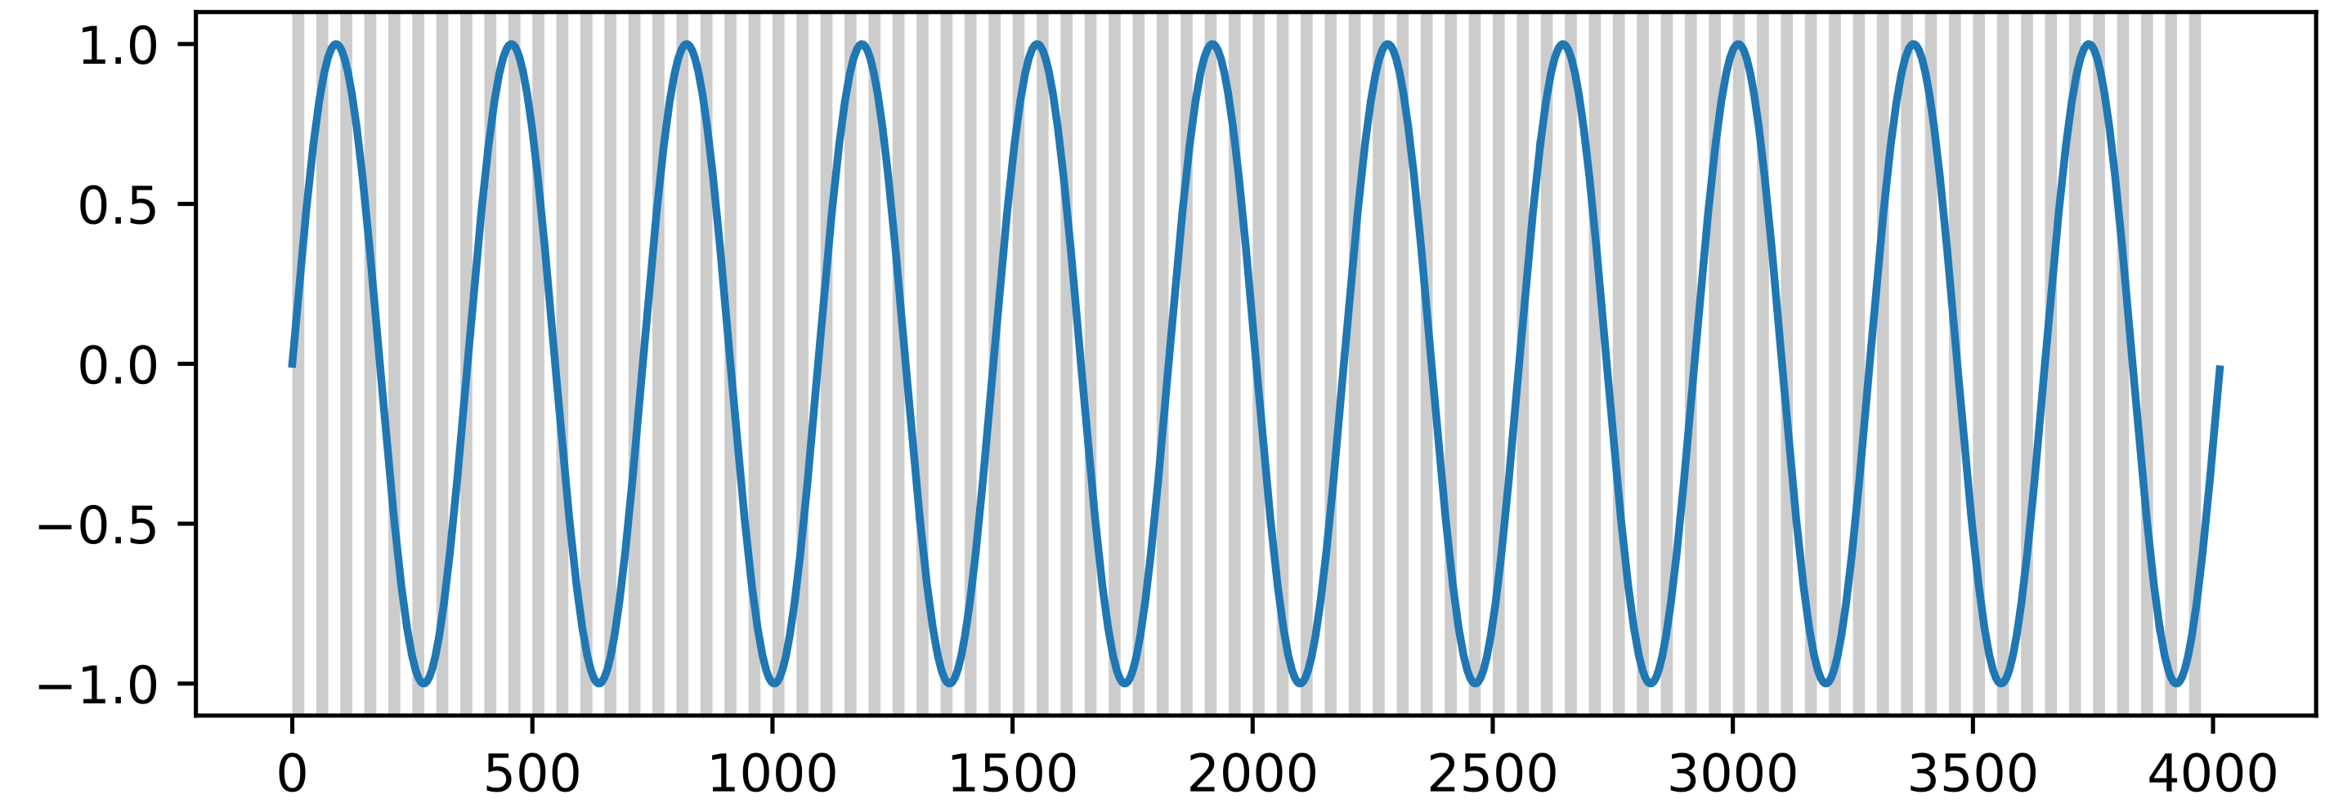
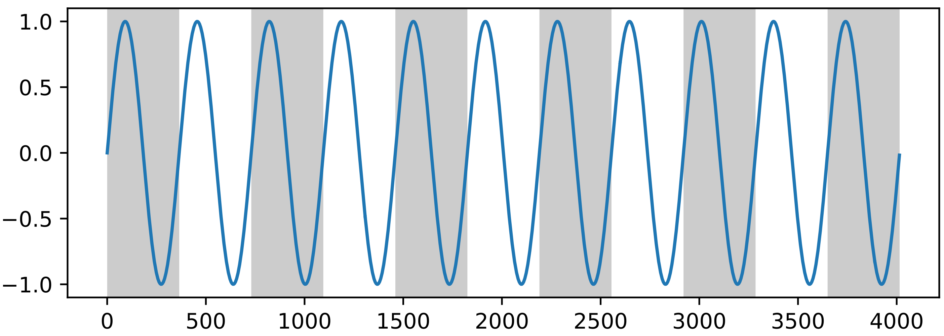
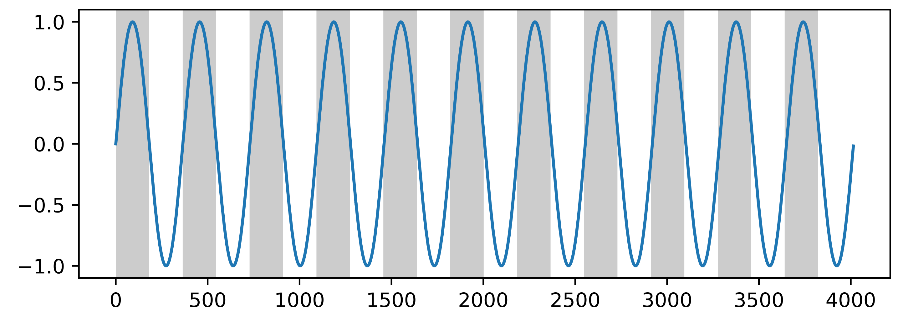
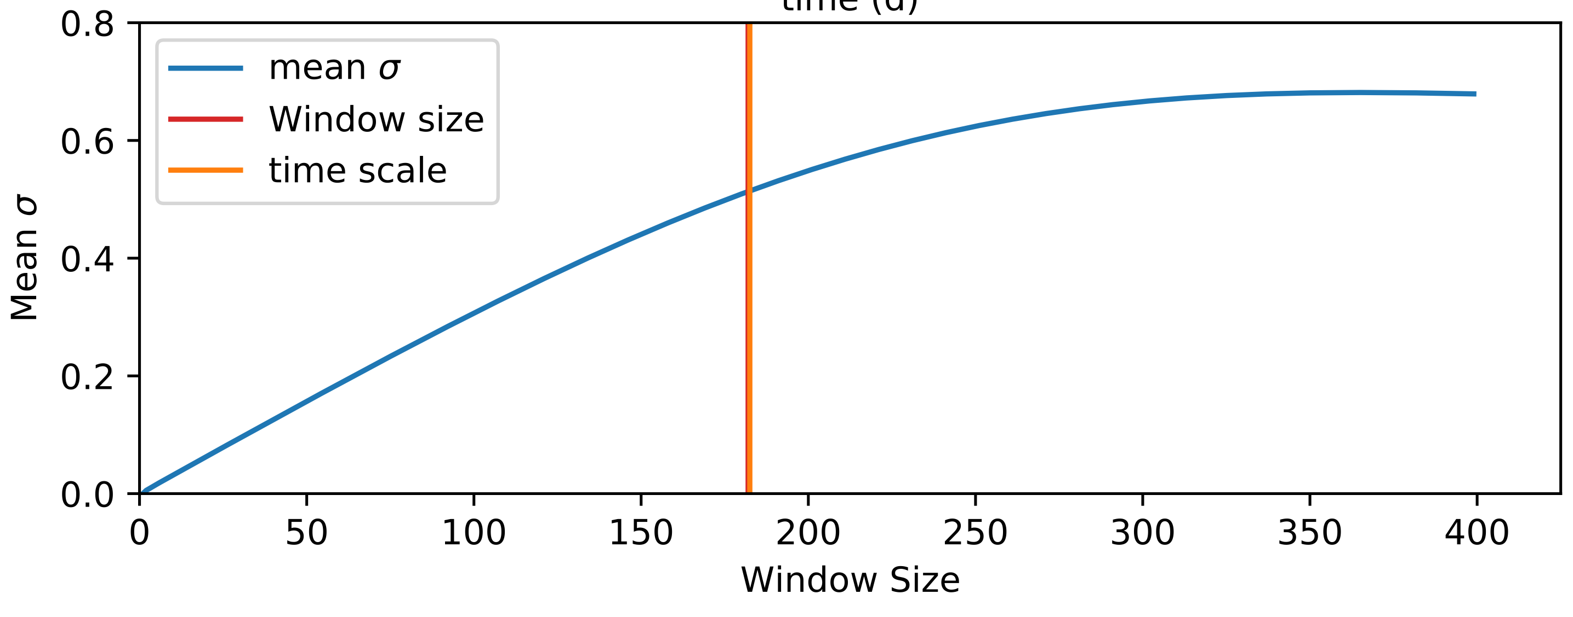

Slide 12
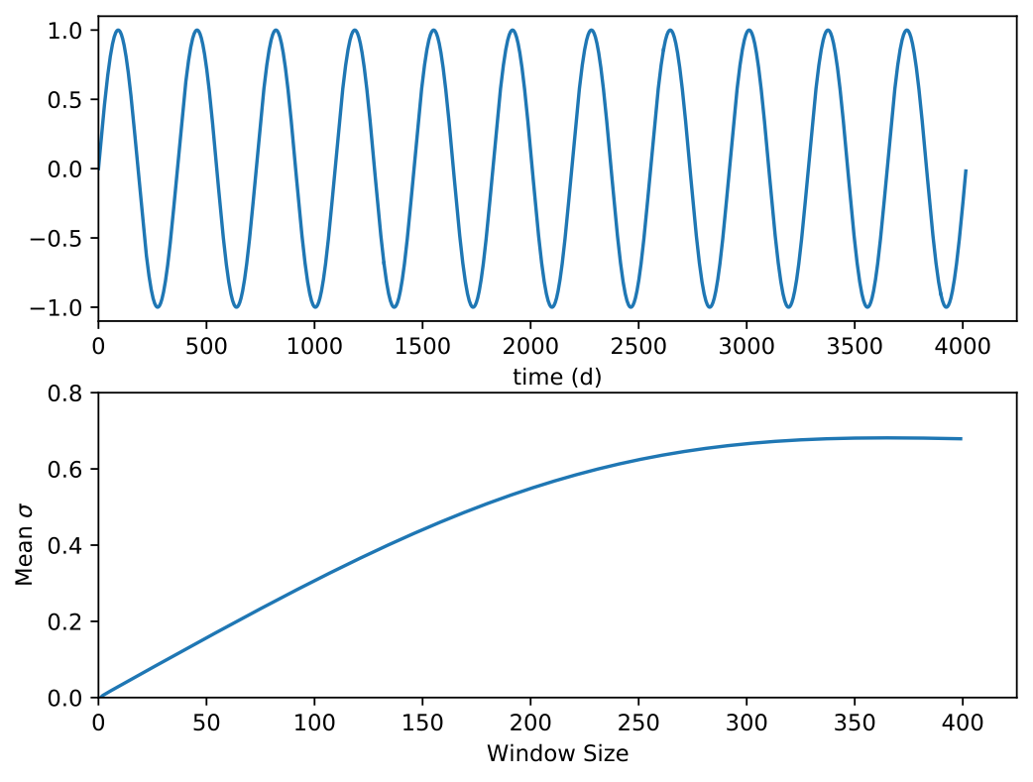
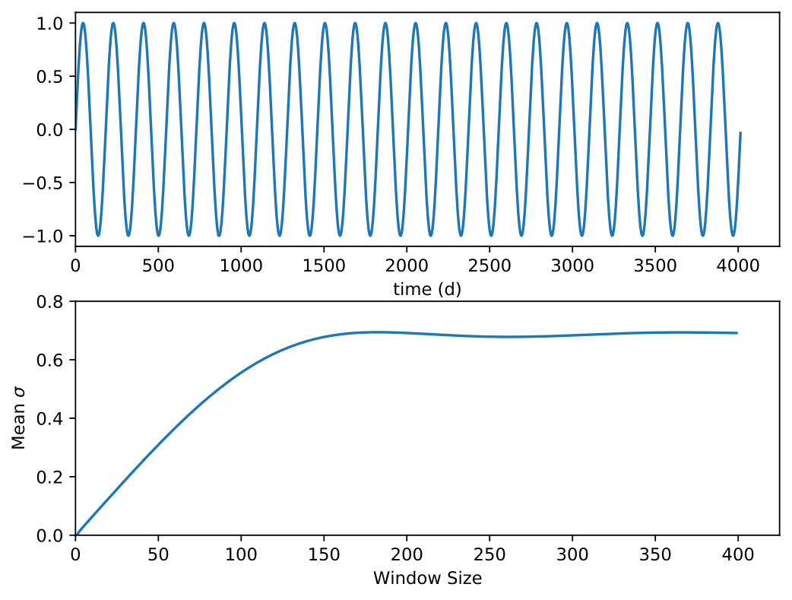
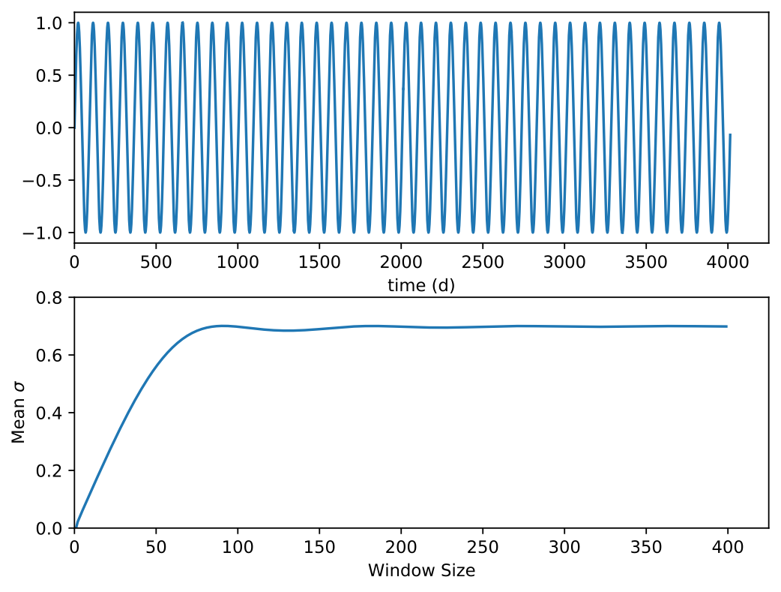
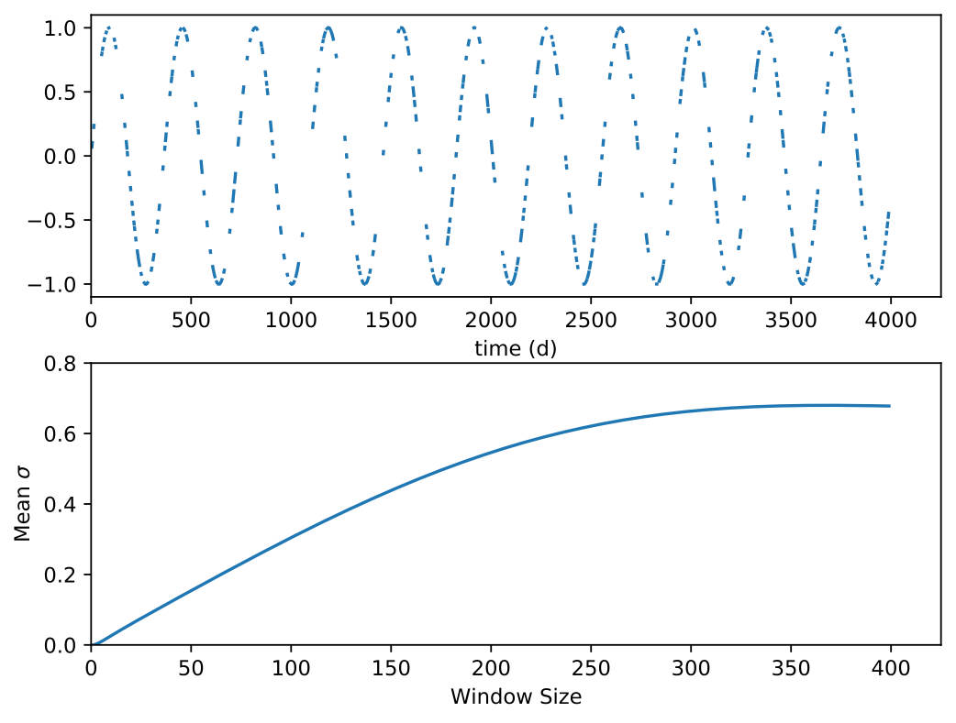
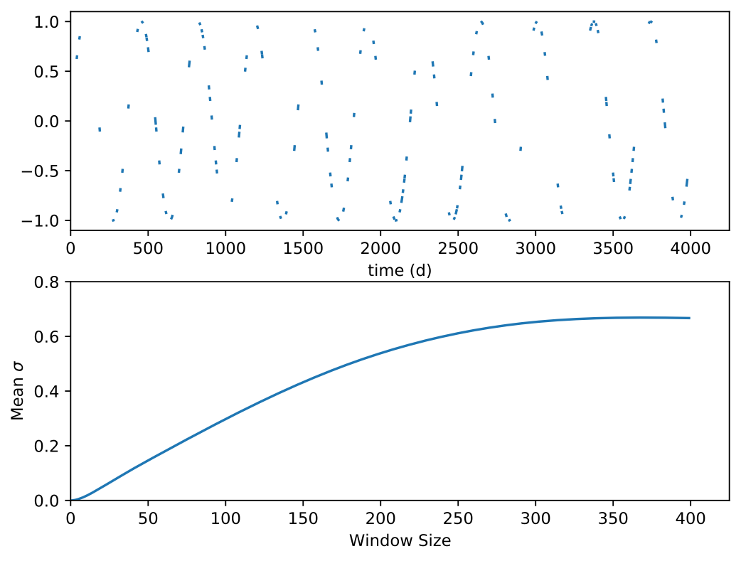
Timescales and slope
0
200
400
0
200
400
0
200
400
Sparsity and slope
Window Size
100%
40%
20%
0
200
400
0
200
400
0
200
400

Slide 13
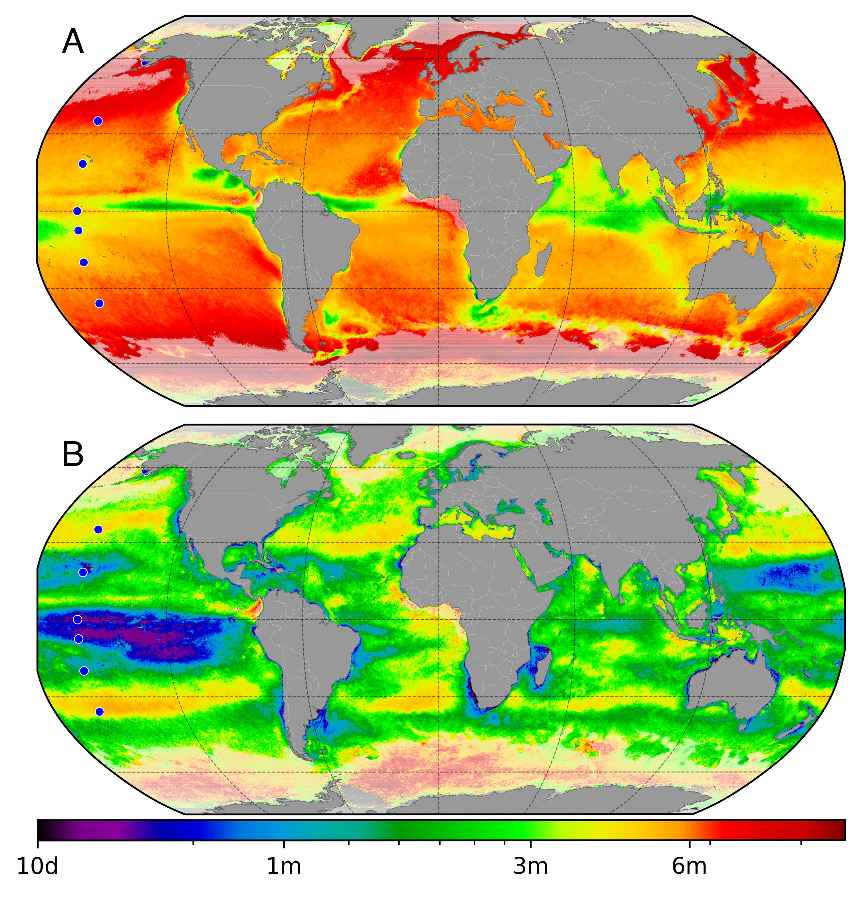
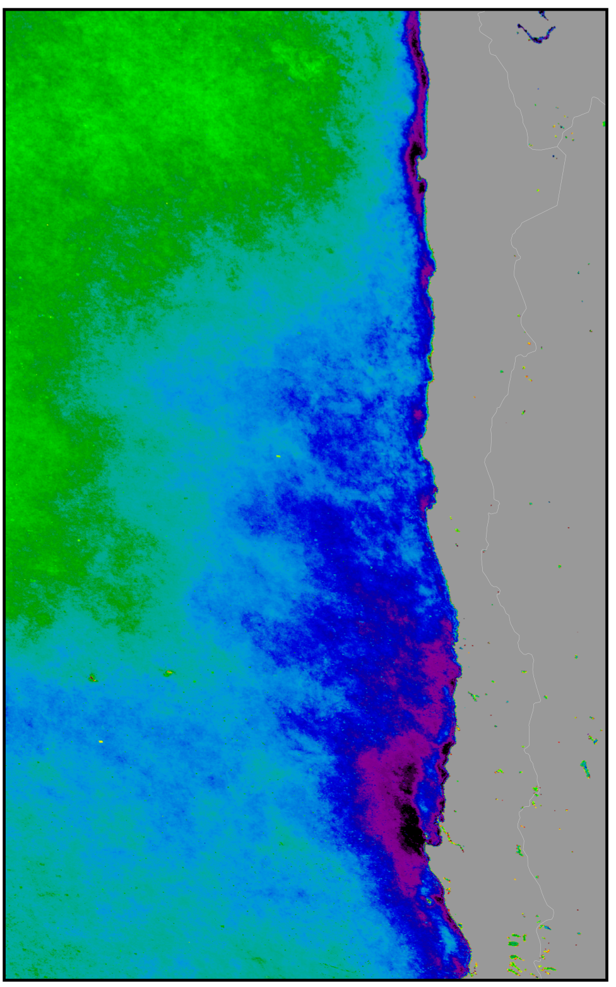
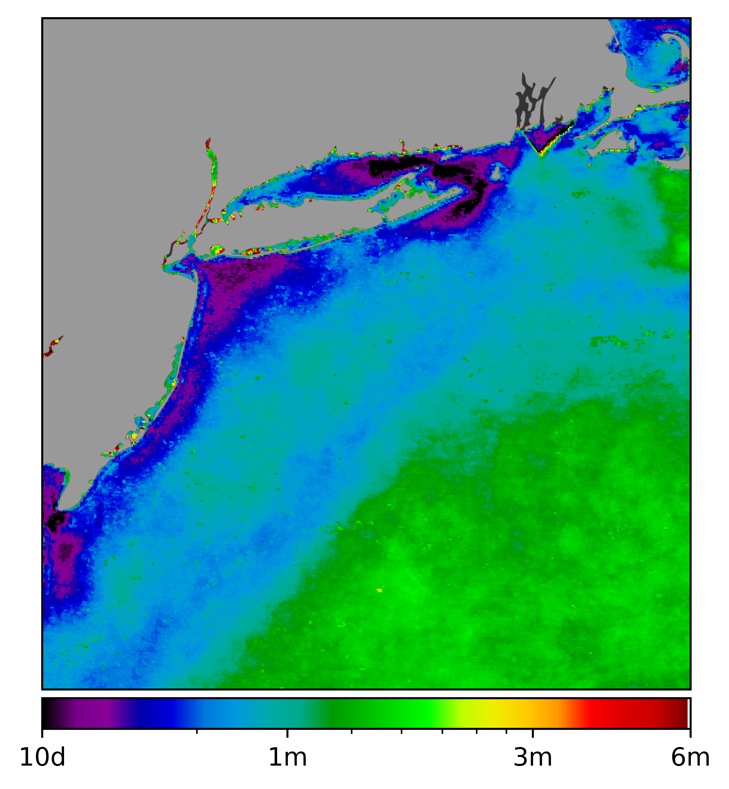
SST
Chl

Slide 14
Primary Production Using a Lagrangian Frame
Dominating timescales of variability
Global Ocean Connectivity and Refuge Regions

Slide 15
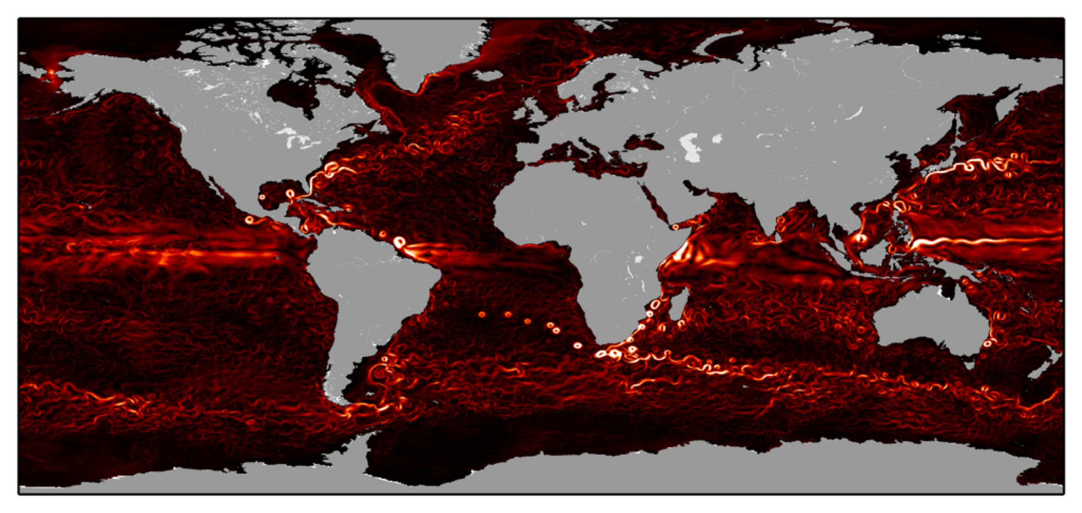
ECCO2 1/4° global state estimate

Slide 16
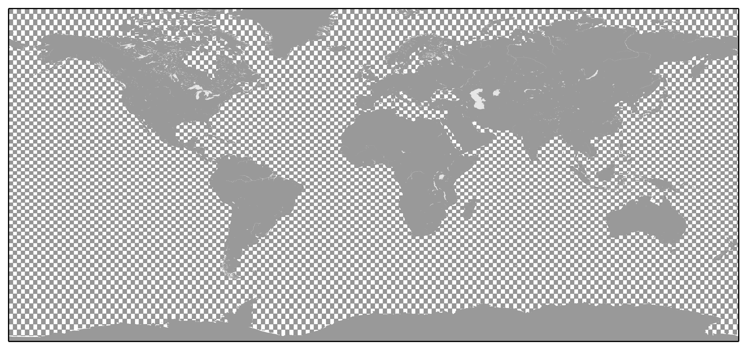
2° x 2° patches for connectivity

Slide 17
Minimum Connectivity Time

Slide 18
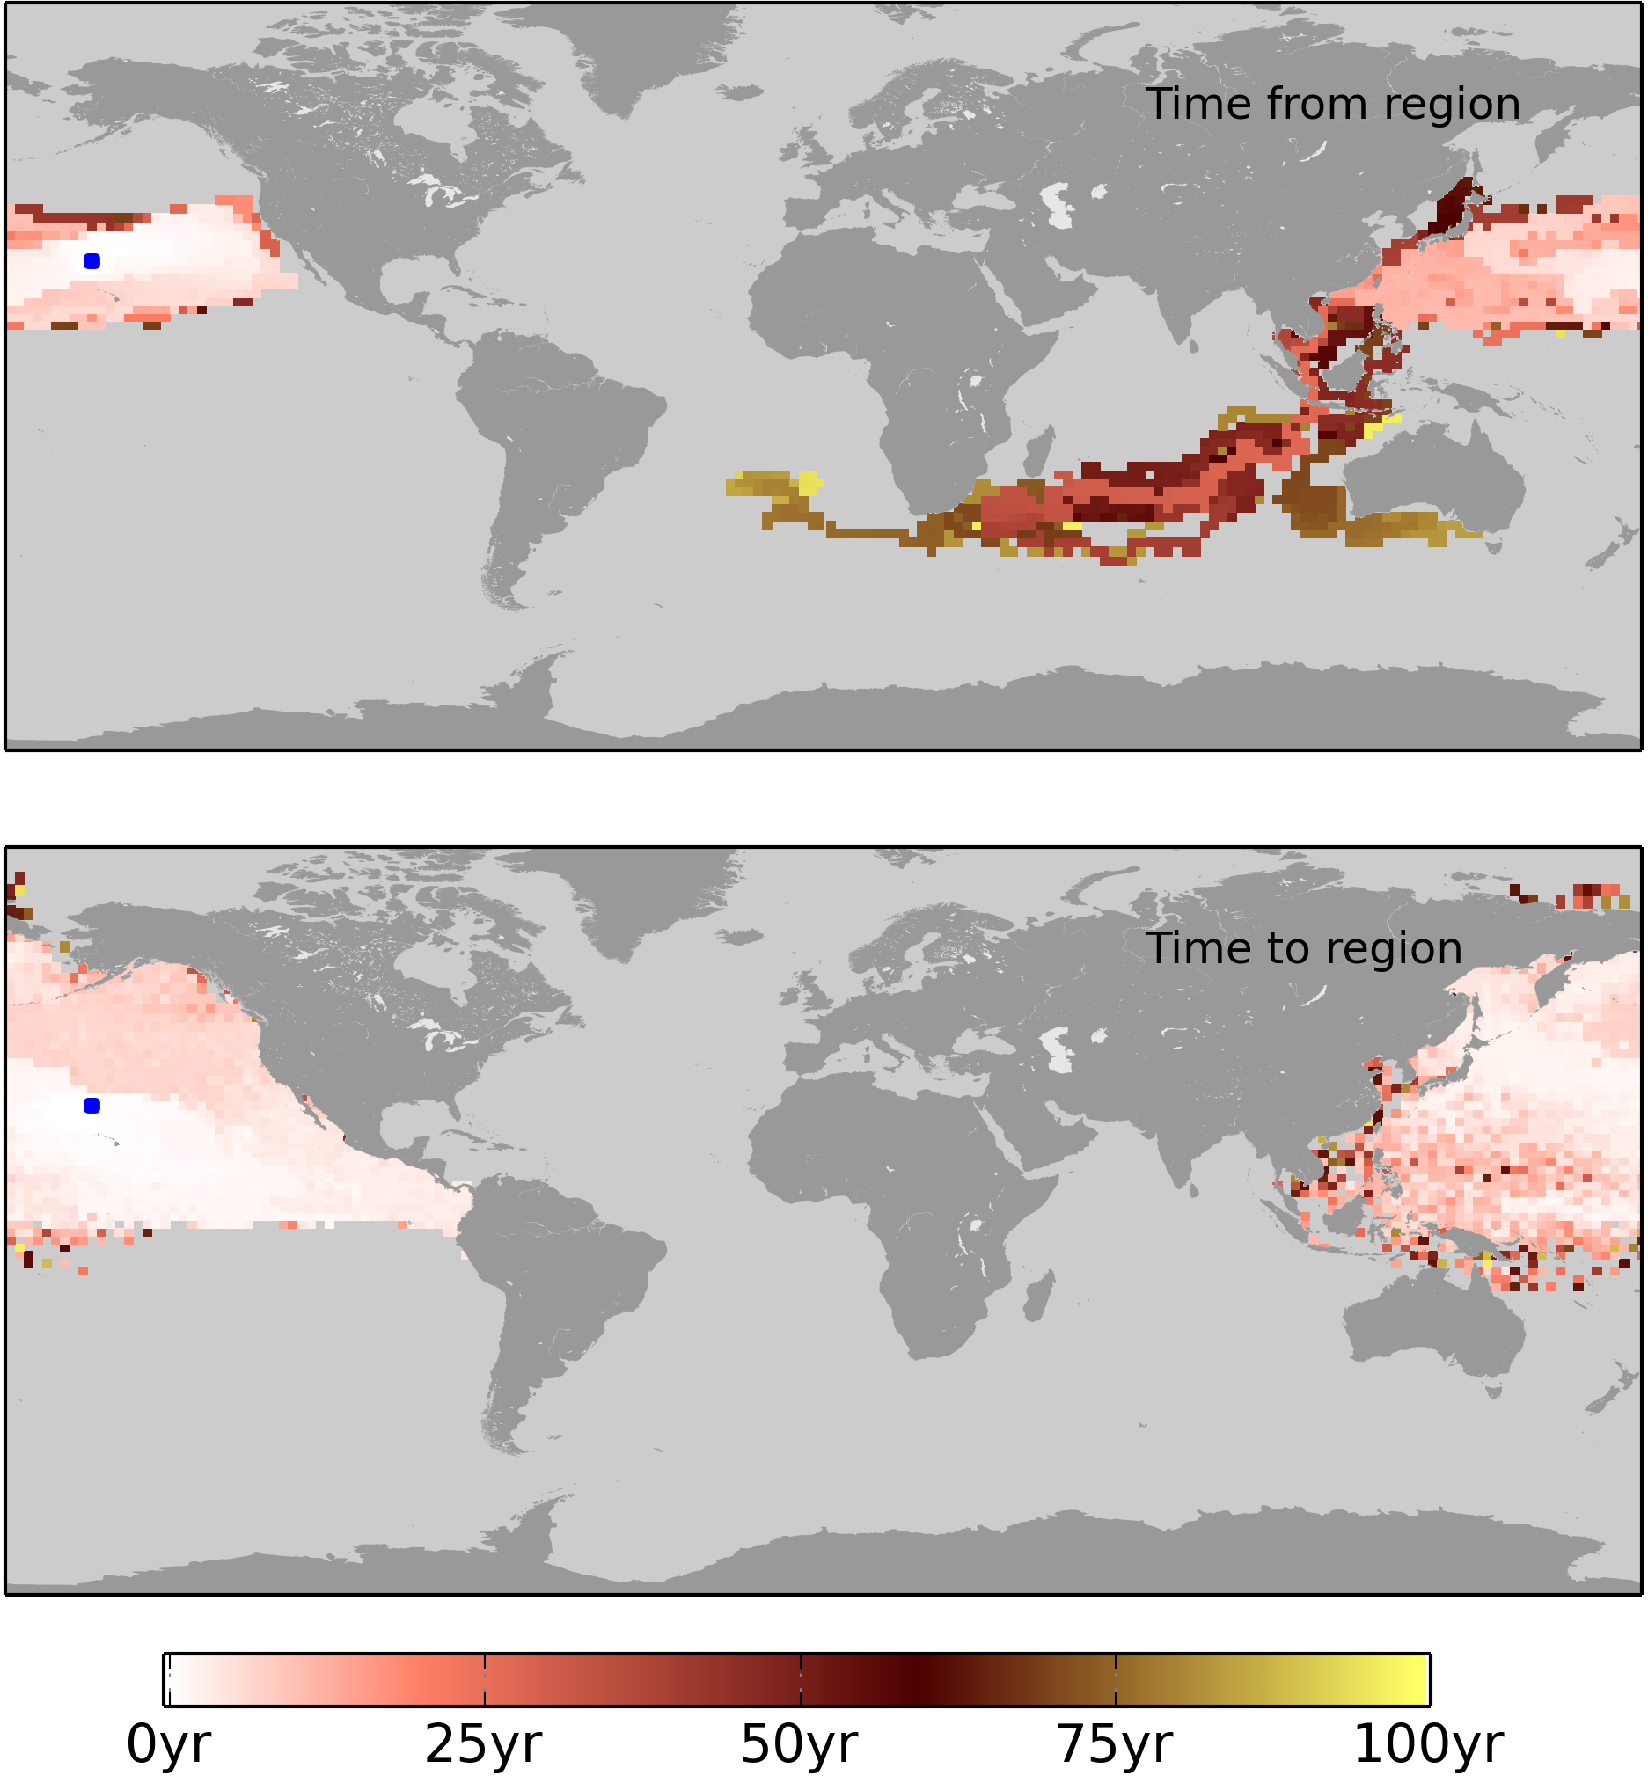
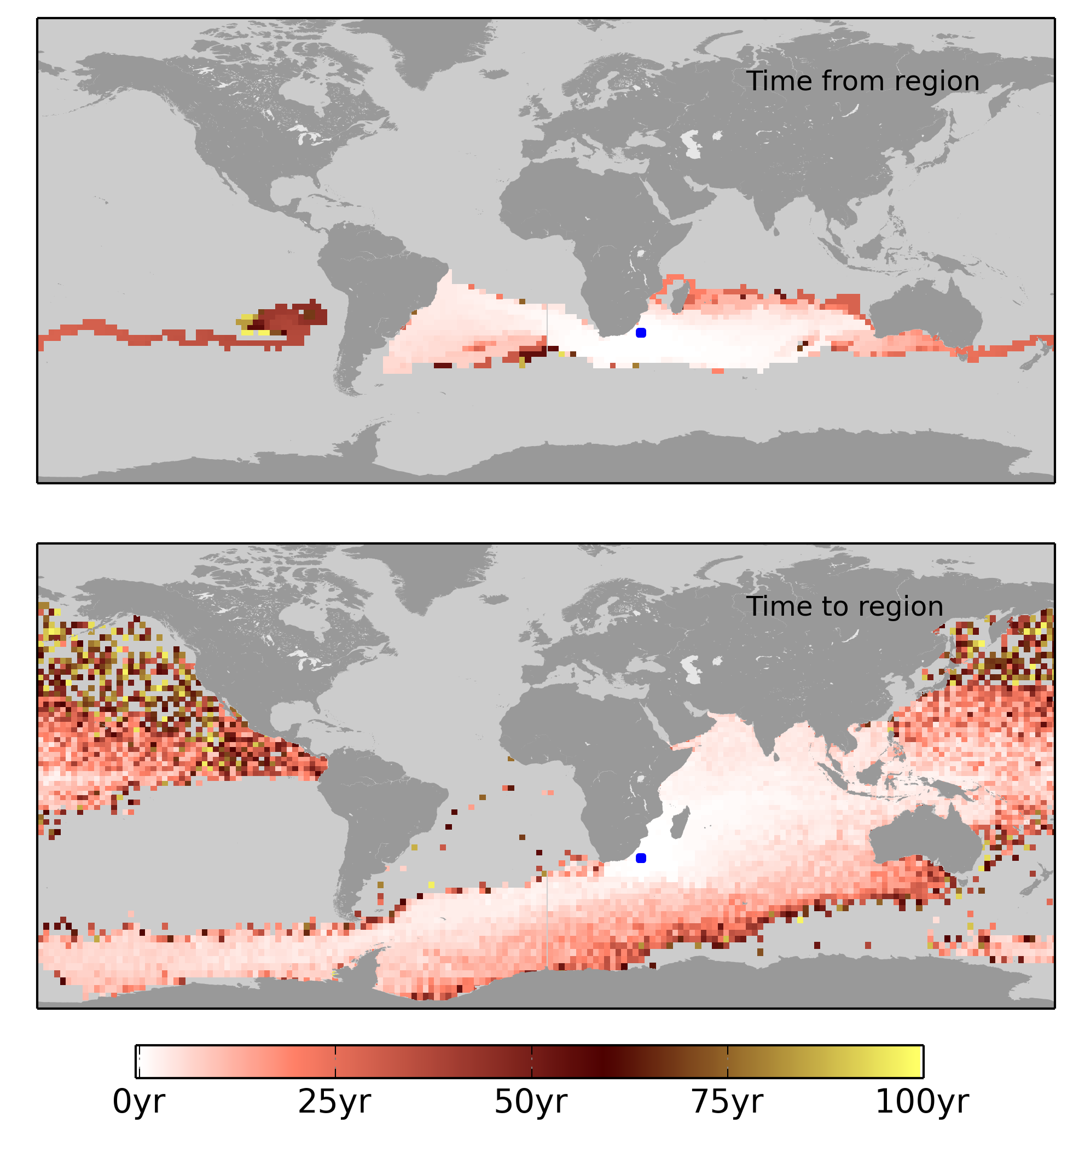

Slide 19
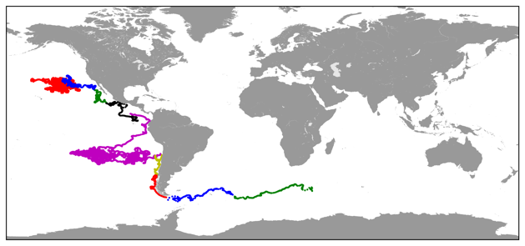

Slide 20
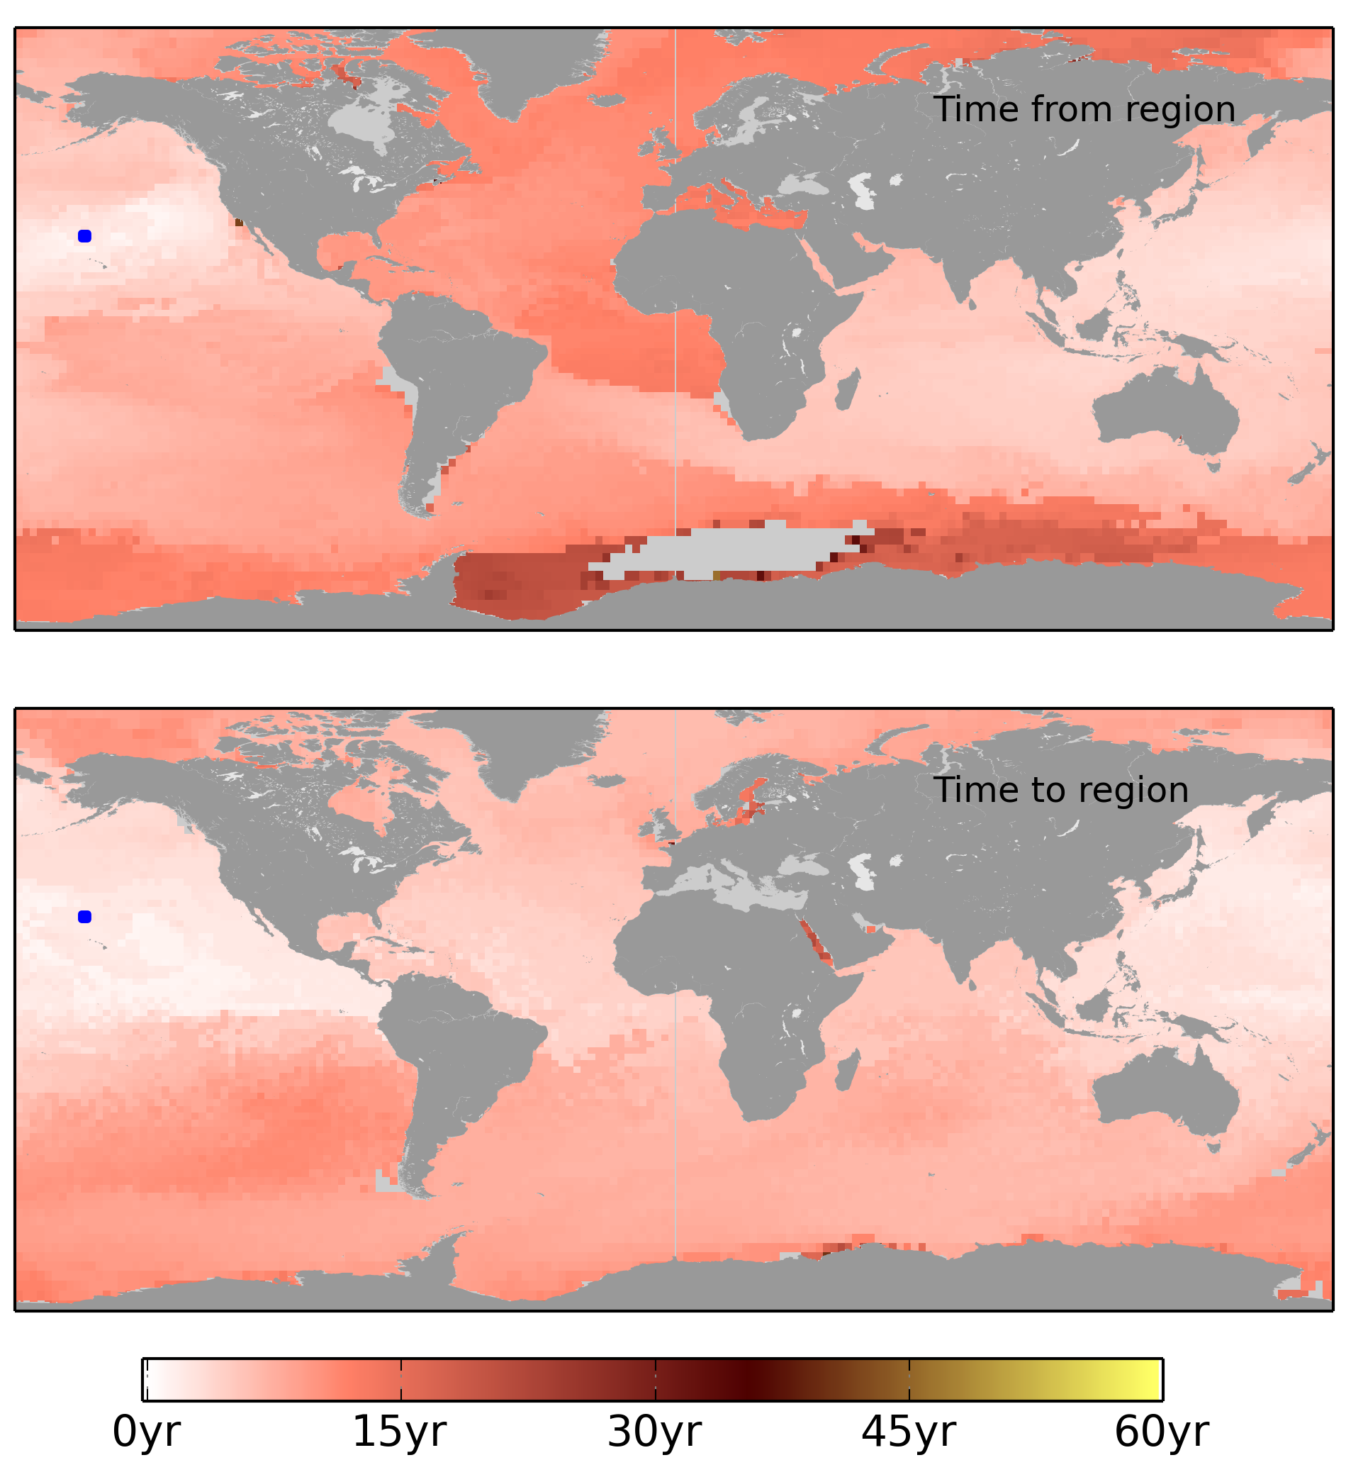
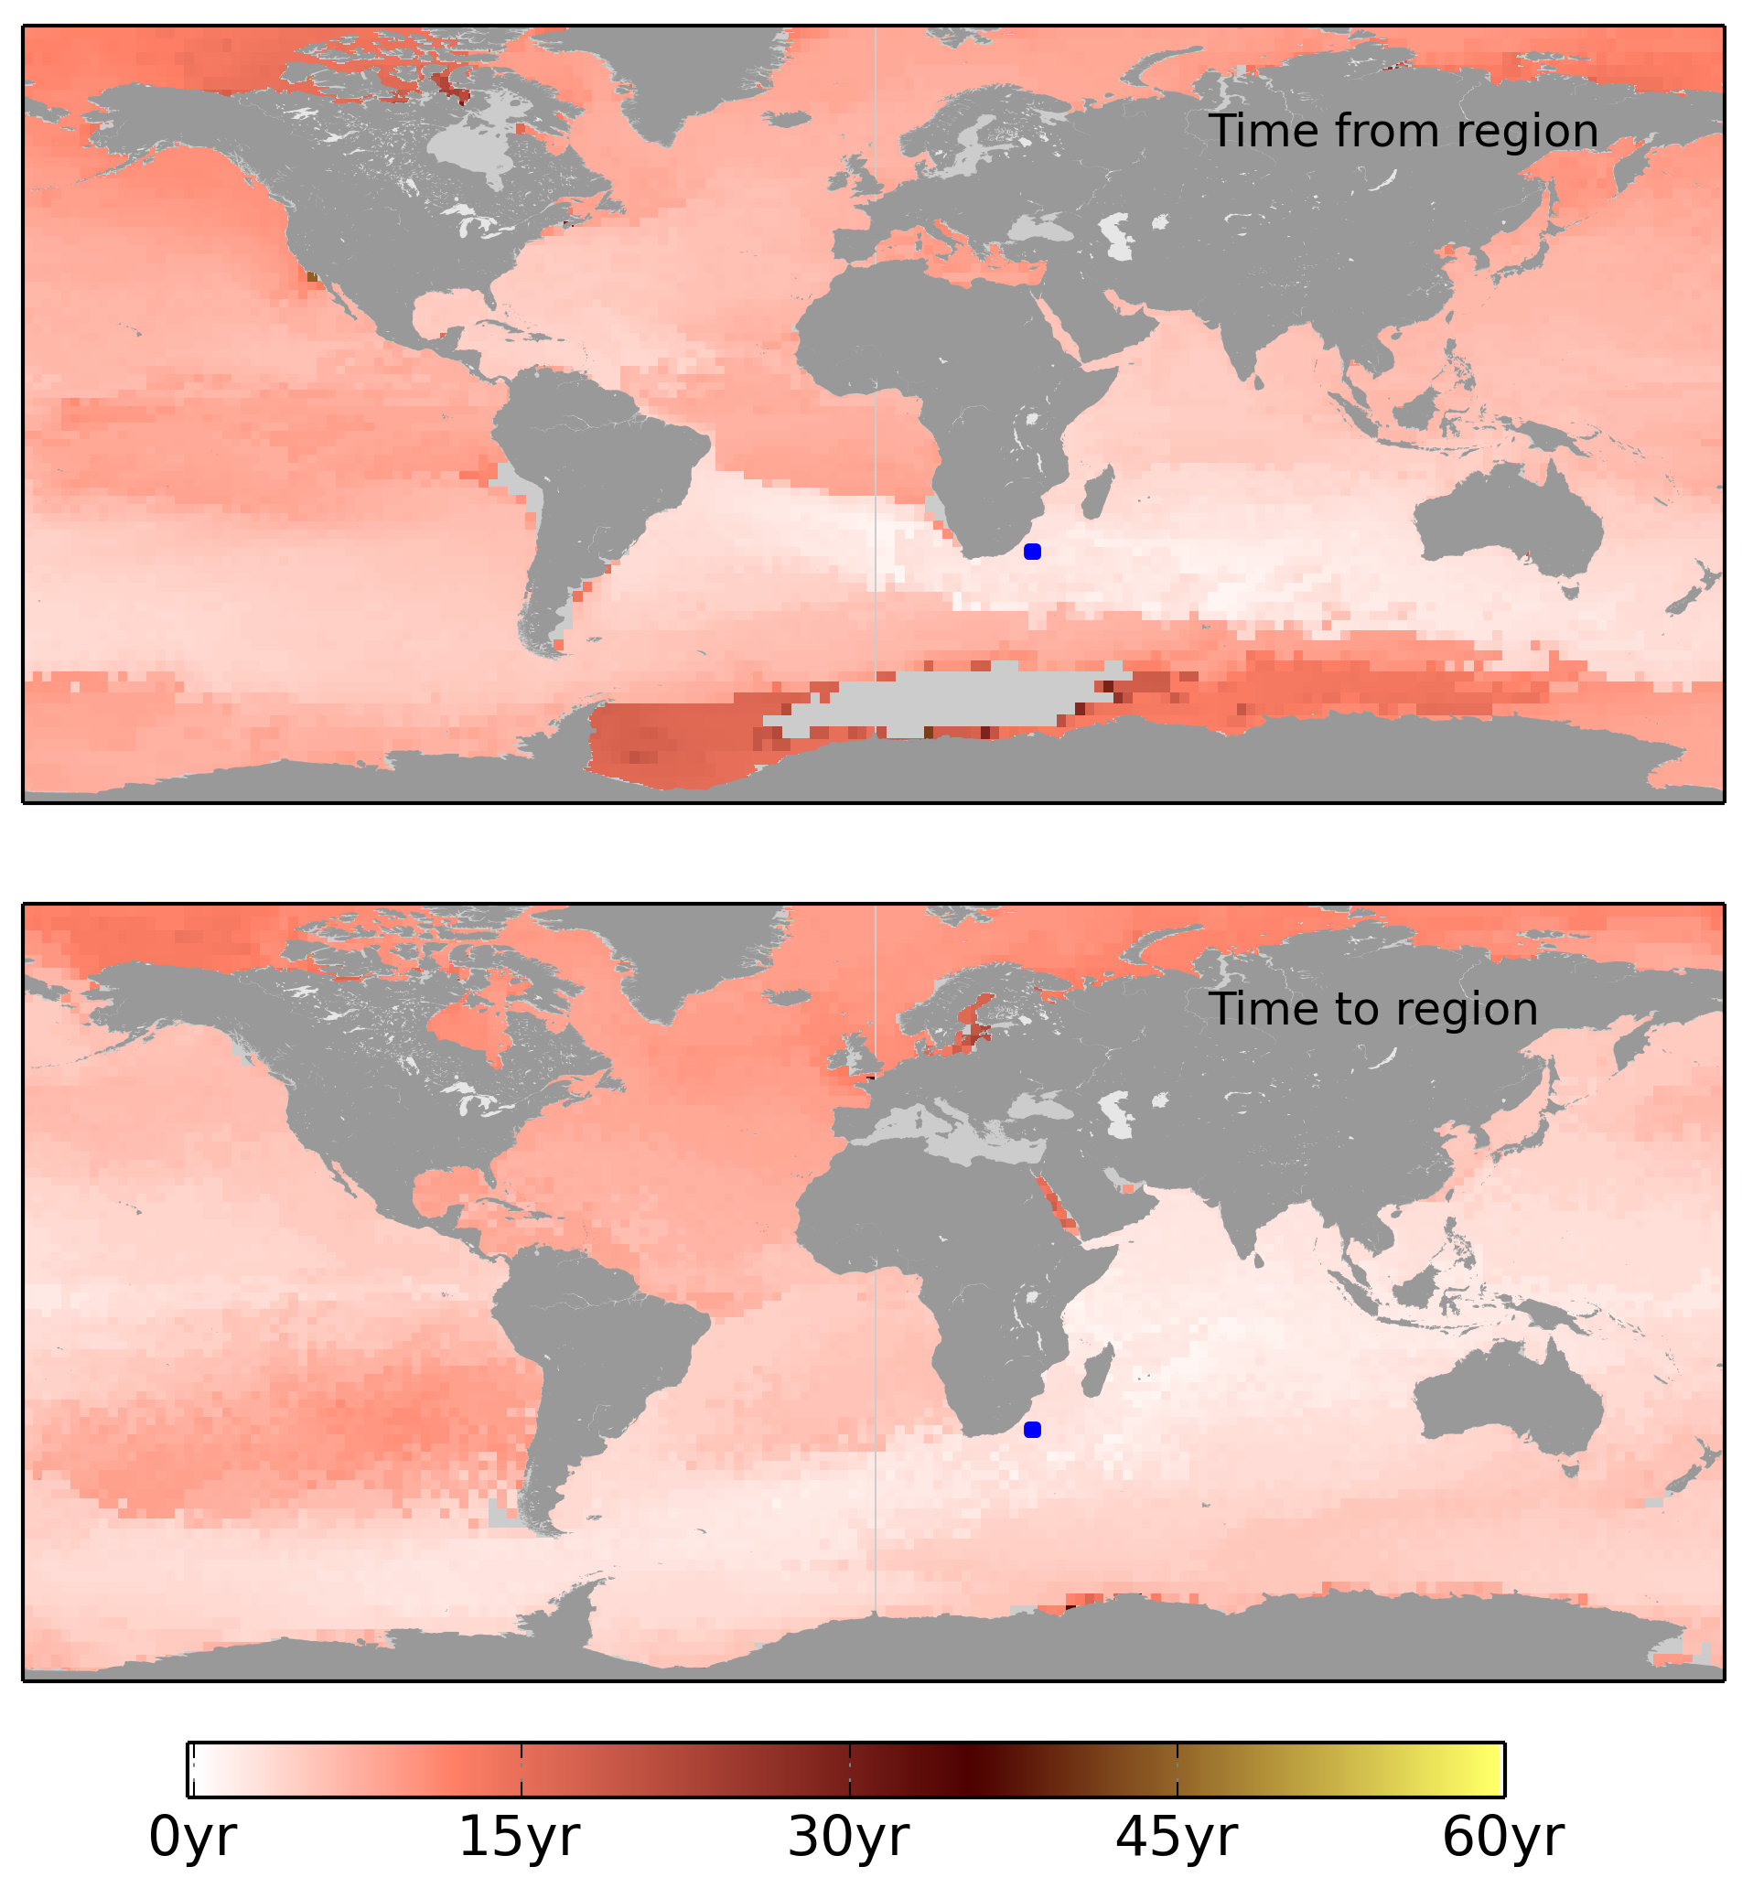

Slide 22
Time to travel 1°C

Slide 23
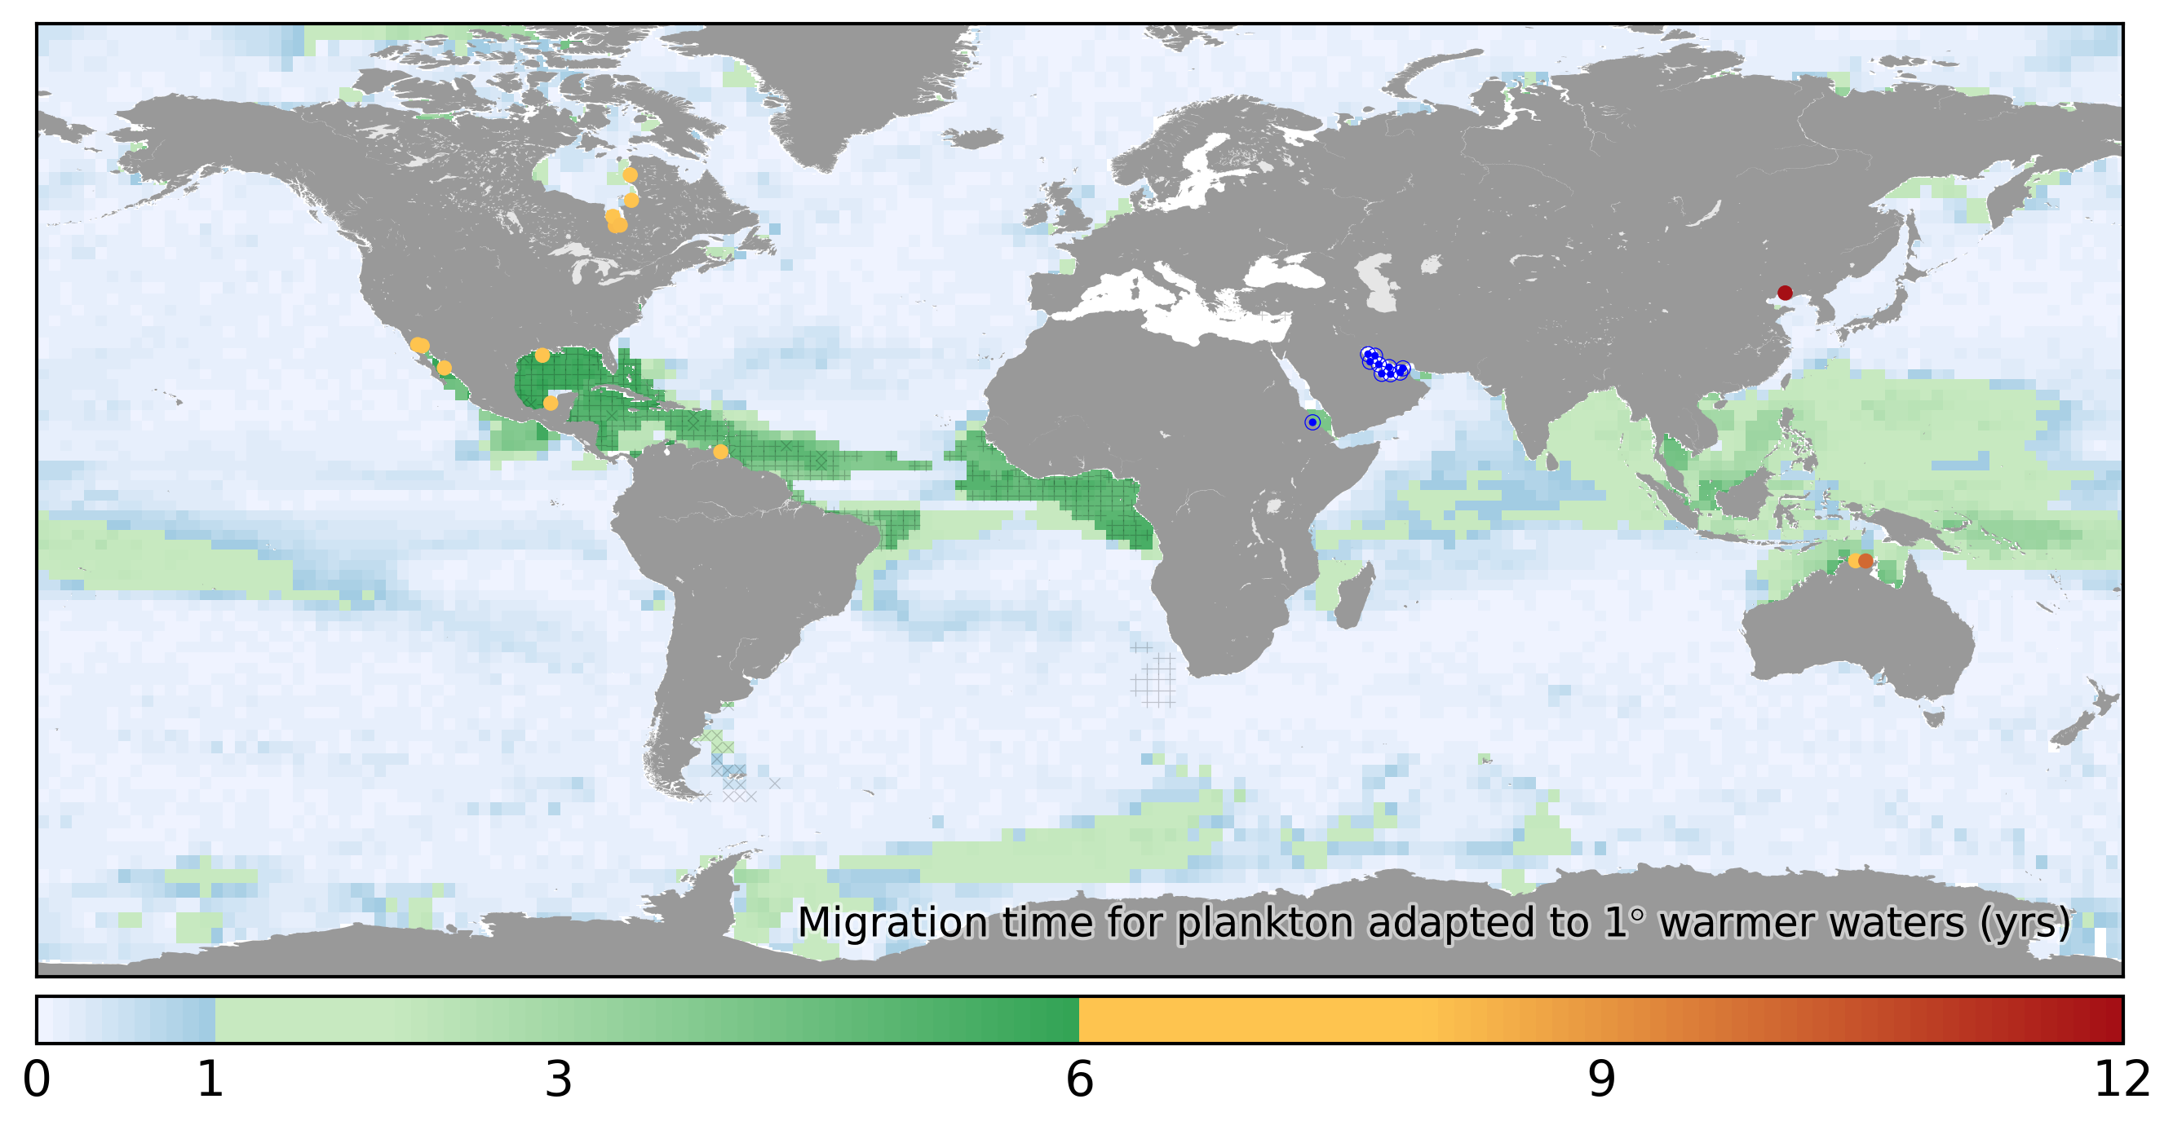
Migration time 1°C
Years

Slide 24
How do we conceptually bridge
connectivity and isolation?

Slide 25
Cartoon Oceanography

Slide 26
http://www.physicalgeography.net

Slide 27
2016-07-14
Copernicus/Mercator 1/12° simulation

Slide 28
bror.jonsson@unh.edu

